Slide 1

Web Application Development
COMP-229
Fall 2023

Slide 2
Integrating Backend API
Users should be able to use the frontend views to fetch and modify user data in the database based on authentication and authorization.
To implement these functionalities, the React components will access the API endpoints that are exposed by the backend using the Fetch API.
The Fetch API is a newer standard that makes network requests similar to XMLHttpRequest (XHR) but using promises instead, enabling a simpler and cleaner API.
To learn more about the Fetch API,
visit https://developer.mozilla.org/en-US/docs/Web/API/Fetch_API

Slide 3
Fetch for user CRUD
In the client/user/api-user.js file, we will add methods for accessing each of the user CRUD API endpoints, which the React components can use to exchange user data with the server and database as required.
In the following sections, we will look at the implementation of these methods and how they correspond to each CRUD endpoint.

Slide 4
Creating a user
The create method will take user data from the view component, which is where we will invoke this method. Then, it will use fetch to make a POST call at the create API route, '/api/users', to create a new user in the backend with the provided data.
mern-skeleton/client/user/api-user.js:
const create = async (user) => {
try {
let response = await fetch('/api/users/', {
method: 'POST',
headers: {
'Accept': 'application/json',
'Content-Type': 'application/json'
},
body: JSON.stringify(user)
})
return await response.json()
} catch(err) {
console.log(err)
}
}

Slide 5
Finally, in this method, we return the response from the server as a promise. So, the component calling this method can use this promise to handle the response appropriately, depending on what is returned from the server.
Similarly, we will implement the list method next.

Slide 6
Listing users
The list method will use fetch to make a GET call to retrieve all the users in the database, and then return the response from the server as a promise to the component.
mern-skeleton/client/user/api-user.js:
const list = async (signal) => {
try {
let response = await fetch('/api/users/', {
method: 'GET',
signal: signal,
})
return await response.json()
} catch(err) {
console.log(err)
}
}

Slide 7
Updated mern-skeleton/client/user/api-user.js:
const create = async (user) => {
try {
let response = await fetch('/api/users/', {
method: 'POST',
headers: {
'Accept': 'application/json',
'Content-Type': 'application/json'
},
body: JSON.stringify(user)
})
return await response.json()
} catch(err) {
console.log(err)
}
}
const list = async (signal) => {
try {
let response = await fetch('/api/users/', {
method: 'GET',
signal: signal,
})
return await response.json()
} catch(err) {
console.log(err)
}
}

Slide 8
The returned promise, if it resolves successfully, will give the component an array containing the user objects that were retrieved from the database.
In the case of a single user read, we will deal with a single user object instead, as demonstrated next.

Slide 9
Reading a user profile
The read method will use fetch to make a GET call to retrieve a specific user by ID.
Since this is a protected route, besides passing the user ID as a parameter, the requesting component must also provide valid credentials, which, in this case, will be a valid JWT received after a successful sign-in.
mern-skeleton/client/user/api-user.js:

Slide 10
const read = async (params, credentials, signal) => {
try {
let response = await fetch('/api/users/' + params.userId, {
method: 'GET',
signal: signal,
headers: {
'Accept': 'application/json',
'Content-Type': 'application/json',
'Authorization': 'Bearer ' + credentials.t
}
})
return await response.json()
} catch(err) {
console.log(err)
}
}

Slide 11
Updated mern-skeleton/client/user/api-user.js:
const create = async (user) => {
try {
let response = await fetch('/api/users/', {
method: 'POST',
headers: {
'Accept': 'application/json',
'Content-Type': 'application/json'
},
body: JSON.stringify(user)
})
return await response.json()
} catch(err) {
console.log(err)
}
}
const list = async (signal) => {
try {
let response = await fetch('/api/users/', {
method: 'GET',
signal: signal,
})
return await response.json()
} catch(err) {
console.log(err)
}
}
const read = async (params, credentials, signal) => {
try {
let response = await fetch('/api/users/' + params.userId, {
method: 'GET',
signal: signal,
headers: {
'Accept': 'application/json',
'Content-Type': 'application/json',
'Authorization': 'Bearer ' + credentials.t
}
})
return await response.json()
} catch(err) {
console.log(err)
}
}

Slide 12
The JWT is attached to the GET fetch call in the Authorization header using the Bearer scheme, and then the response from the server is returned to the component in a promise.
This promise, when it resolves, will either give the component the user details for the specific user or notify that access is restricted to authenticated users.
Similarly, the updated user API method also needs to be passed valid JWT credentials for the fetch call, as shown in the next section.

Slide 13
Updating a user's data
The update method will take changed user data from the view component for a specific user, then use fetch to make a PUT call to update the existing user in the backend.
This is also a protected route that will require a valid JWT as the credential.

Slide 14
mern-skeleton/client/user/api-user.js:
const update = async (params, credentials, user) => {
try {
let response = await fetch('/api/users/' + params.userId, {
method: 'PUT',
headers: {
'Accept': 'application/json',
'Content-Type': 'application/json',
'Authorization': 'Bearer ' + credentials.t
},
body: JSON.stringify(user)
})
return await response.json()
} catch(err) {
console.log(err)
}
}

Slide 15
Updated mern-skeleton/client/user/api-user.js:
const create = async (user) => {
try {
let response = await fetch('/api/users/', {
method: 'POST',
headers: {
'Accept': 'application/json',
'Content-Type': 'application/json'
},
body: JSON.stringify(user)
})
return await response.json()
} catch(err) {
console.log(err)
}
}
const list = async (signal) => {
try {
let response = await fetch('/api/users/', {
method: 'GET',
signal: signal,
})
return await response.json()
} catch(err) {
console.log(err)
}
}
const read = async (params, credentials, signal) => {
try {
let response = await fetch('/api/users/' + params.userId, {
method: 'GET',
signal: signal,
headers: {
'Accept': 'application/json',
'Content-Type': 'application/json',
'Authorization': 'Bearer ' + credentials.t
}
})
return await response.json()
} catch(err) {
console.log(err)
}
}
const update = async (params, credentials, user) => {
try {
let response = await fetch('/api/users/' + params.userId, {
method: 'PUT',
headers: {
'Accept': 'application/json',
'Content-Type': 'application/json',
'Authorization': 'Bearer ' + credentials.t
},
body: JSON.stringify(user)
})
return await response.json()
} catch(err) {
console.log(err)
}
}

Slide 16
As we have seen with the other fetch calls, this method will also return a promise containing the server's response to the user update request.
In the final method, we will learn how to call the user delete API.

Slide 17
Deleting a user
The remove method will allow the view component to delete a specific user from the database and use fetch to make a DELETE call.
This, again, is a protected route that will require a valid JWT as a credential, similar to the read and update methods.
mern-skeleton/client/user/api-user.js:

Slide 18
const remove = async (params, credentials) => {
try {
let response = await fetch('/api/users/' + params.userId, {
method: 'DELETE',
headers: {
'Accept': 'application/json',
'Content-Type': 'application/json',
'Authorization': 'Bearer ' + credentials.t
}
})
return await response.json()
} catch(err) {
console.log(err)
}
}

Slide 19
Updated mern-skeleton/client/user/api-user.js:
const create = async (user) => {
try {
let response = await fetch('/api/users/', {
method: 'POST',
headers: {
'Accept': 'application/json',
'Content-Type': 'application/json'
},
body: JSON.stringify(user)
})
return await response.json()
} catch(err) {
console.log(err)
}
}
const list = async (signal) => {
try {
let response = await fetch('/api/users/', {
method: 'GET',
signal: signal,
})
return await response.json()
} catch(err) {
console.log(err)
}
}
const read = async (params, credentials, signal) => {
try {
let response = await fetch('/api/users/' + params.userId, {
method: 'GET',
signal: signal,
headers: {
'Accept': 'application/json',
'Content-Type': 'application/json',
'Authorization': 'Bearer ' + credentials.t
}
})
return await response.json()
} catch(err) {
console.log(err)
}
}
const update = async (params, credentials, user) => {
try {
let response = await fetch('/api/users/' + params.userId, {
method: 'PUT',
headers: {
'Accept': 'application/json',
'Content-Type': 'application/json',
'Authorization': 'Bearer ' + credentials.t
},
body: JSON.stringify(user)
})
return await response.json()
} catch(err) {
console.log(err)
}
}
const remove = async (params, credentials) => {
try {
let response = await fetch('/api/users/' + params.userId, {
method: 'DELETE',
headers: {
'Accept': 'application/json',
'Content-Type': 'application/json',
'Authorization': 'Bearer ' + credentials.t
}
})
return await response.json()
} catch(err) {
console.log(err)
}
}

Slide 20
The response from the server to the delete request will be returned to the component as a promise, as in the other methods.
In these five helper methods, we have covered calls to all the user CRUD-related API endpoints that we implemented on the backend.
Finally, we can export these methods from the api-user.js file as follows.
mern-skeleton/client/user/api-user.js:
export { create, list, read, update, remove }

Slide 21
Updated mern-skeleton/client/user/api-user.js:
const create = async (user) => {
try {
let response = await fetch('/api/users/', {
method: 'POST',
headers: {
'Accept': 'application/json',
'Content-Type': 'application/json'
},
body: JSON.stringify(user)
})
return await response.json()
} catch(err) {
console.log(err)
}
}
const list = async (signal) => {
try {
let response = await fetch('/api/users/', {
method: 'GET',
signal: signal,
})
return await response.json()
} catch(err) {
console.log(err)
}
}
const read = async (params, credentials, signal) => {
try {
let response = await fetch('/api/users/' + params.userId, {
method: 'GET',
signal: signal,
headers: {
'Accept': 'application/json',
'Content-Type': 'application/json',
'Authorization': 'Bearer ' + credentials.t
}
})
return await response.json()
} catch(err) {
console.log(err)
}
}
const update = async (params, credentials, user) => {
try {
let response = await fetch('/api/users/' + params.userId, {
method: 'PUT',
headers: {
'Accept': 'application/json',
'Content-Type': 'application/json',
'Authorization': 'Bearer ' + credentials.t
},
body: JSON.stringify(user)
})
return await response.json()
} catch(err) {
console.log(err)
}
}
const remove = async (params, credentials) => {
try {
let response = await fetch('/api/users/' + params.userId, {
method: 'DELETE',
headers: {
'Accept': 'application/json',
'Content-Type': 'application/json',
'Authorization': 'Bearer ' + credentials.t
}
})
return await response.json()
} catch(err) {
console.log(err)
}
}
export { create, list, read, update, remove }

Slide 22
These user CRUD methods can now be imported and used by the React components as required.
Next, we will implement similar helper methods to integrate the auth-related API endpoints.

Slide 23
Fetch for the auth API
In order to integrate the auth API endpoints from the server with the frontend
React components, we will add methods for fetching sign-in and sign-out API
endpoints in the client/auth/api-auth.js file. Let's take a look at them.

Slide 24
Sign-in
The signin method will take user sign-in data from the view component, then use fetch to make a POST call to verify the user with the backend.
mern-skeleton/client/auth/api-auth.js:
const signin = async (user) => {
try {
let response = await fetch('/auth/signin/', {
method: 'POST',
headers: {
'Accept': 'application/json',
'Content-Type': 'application/json'
},
credentials: 'include',
body: JSON.stringify(user)
})
return await response.json()
} catch(err) {
console.log(err)
}
}

Slide 25
The response from the server will be returned to the component in a promise, which may provide the JWT if sign-in was successful.
The component invoking this method needs to handle the response appropriately, such as storing the received JWT locally so it can be used when making calls to other protected API routes from the frontend.
We will look at the implementation for this when we implement the Sign In view later.
After the user is successfully signed in, we also want the option to call the signout API when the user is signing out.
The call to the signout API is discussed next.

Slide 26
Sign-out
We will add a signout method to api-auth.js, which will use fetch to make a GET call to the signout API endpoint on the server.
mern-skeleton/client/auth/api-auth.js:
const signout = async () => {
try {
let response = await fetch('/auth/signout/', { method: 'GET' })
return await response.json()
} catch(err) {
console.log(err)
}
}

Slide 27
Updated mern-skeleton/client/auth/api-auth.js:
const signin = async (user) => {
try {
let response = await fetch('/auth/signin/', {
method: 'POST',
headers: {
'Accept': 'application/json',
'Content-Type': 'application/json'
},
credentials: 'include',
body: JSON.stringify(user)
})
return await response.json()
} catch(err) {
console.log(err)
}
}
const signout = async () => {
try {
let response = await fetch('/auth/signout/', { method: 'GET' })
return await response.json()
} catch(err) {
console.log(err)
}
}

Slide 28
This method will also return a promise to inform the component about whether the API request was successful.
At the end of the api-auth.js file, we will export the signin and signout methods.
mern-skeleton/client/auth/api-auth.js:
export { signin, signout }

Slide 29
Updated mern-skeleton/client/auth/api-auth.js:
const signin = async (user) => {
try {
let response = await fetch('/auth/signin/', {
method: 'POST',
headers: {
'Accept': 'application/json',
'Content-Type': 'application/json'
},
credentials: 'include',
body: JSON.stringify(user)
})
return await response.json()
} catch(err) {
console.log(err)
}
}
const signout = async () => {
try {
let response = await fetch('/auth/signout/', { method: 'GET' })
return await response.json()
} catch(err) {
console.log(err)
}
}
export { signin, signout }

Slide 30
Now, these methods can be imported into the relevant React components so that we can implement the user sign-in and signout features.
With these API fetch methods added, the React frontend has complete access to the endpoints we made available in the backend.
Before we start putting these methods to use in our React components, we will look into how user auth state can be maintained across the frontend.

Slide 31
Adding auth in the frontend
As we discussed earlier, implementing authentication with JWT relinquishes responsibility to the client-side to manage and store user auth state.
To this end, we need to write code that will allow the client-side to store the JWT that's received from the server on successful sign-in, make it available when accessing protected routes, delete or invalidate the token when the user signs out, and also restrict access to views and components on the frontend based on the user auth state.

Slide 32
Using examples of the auth workflow from the React Router documentation, in the following sections, we will write helper methods to manage the auth state across the components, and also use a custom PrivateRoute component to add protected routes to the frontend of the MERN skeleton application.

Slide 33
Managing auth state
To manage auth state in the frontend of the application, the frontend needs to be able to store, retrieve, and delete the auth credentials that are received from the server on successful user sign in.
In our MERN applications, we will use the browser's sessionsStorage as the storage option to store the JWT auth credentials.
Alternatively, you can use localStorage instead of sessionStorage to store the JWT credentials.
With sessionStorage, the user auth state will only be remembered in the current window tab.
With localStorage, the user auth state will be remembered across tabs in a browser.

Slide 34
In client/auth/auth-helper.js, we will define the helper methods discussed in the following sections to store and retrieve JWT credentials from client-side sessionStorage, and also clear out the sessionStorage on user sign-out.

Slide 35
Saving credentials
In order to save the JWT credentials that are received from the server on successful sign-in, we use the authenticate method, which is defined as follows.
mern-skeleton/client/auth/auth-helper.js:
authenticate(jwt, cb) {
if(typeof window !== "undefined")
sessionStorage.setItem('jwt', JSON.stringify(jwt))
cb()
}

Slide 36
The authenticate method takes the JWT credentials, jwt, and a callback function, cb, as arguments.
It stores the credentials in sessionStorage after ensuring window is defined, in other words ensuring this code is running in a browser and hence has access to sessionStorage.
Then, it executes the callback function that is passed in. This callback will allow the component – in our case, the component where sign-in is called – to define actions that should take place after successfully signing in and storing credentials.
Next, we will discuss the method that lets us access these stored credentials.

Slide 37
Retrieving credentials
In our frontend components, we will need to retrieve the stored credentials to check if the current user is signed in.
In the isAuthenticated() method, we can retrieve these credentials from sessionStorage.
mern-skeleton/client/auth/auth-helper.js:
isAuthenticated() {
if (typeof window == "undefined")
return false
if (sessionStorage.getItem('jwt'))
return JSON.parse(sessionStorage.getItem('jwt'))
else
return false
}

Slide 38
Updated mern-skeleton/client/auth/auth-helper.js:
authenticate(jwt, cb) {
if(typeof window !== "undefined")
sessionStorage.setItem('jwt', JSON.stringify(jwt))
cb()
}
isAuthenticated() {
if (typeof window == "undefined")
return false
if (sessionStorage.getItem('jwt'))
return JSON.parse(sessionStorage.getItem('jwt'))
else
return false
}

Slide 39
A call to isAuthenticated() will return either the stored credentials or false, depending on whether credentials were found in sessionStorage.
Finding credentials in storage will mean a user is signed in, whereas not finding credentials will mean the user is not signed in. We will also add a method that allows us to delete the credentials from storage when a signed-in user signs out from the application.

Slide 40
Deleting credentials
When a user successfully signs out from the application, we want to clear the stored JWT credentials from sessionStorage.
This can be accomplished by calling the clearJWT method, which is defined in the following code.
mern-skeleton/client/auth/auth-helper.js:
clearJWT(cb) {
if(typeof window !== "undefined")
sessionStorage.removeItem('jwt')
cb()
signout().then((data) => {
document.cookie = "t=; expires=Thu, 01 Jan 1970 00:00:00
UTC; path=/;"
})
}

Slide 41
Updated mern-skeleton/client/auth/auth-helper.js:
authenticate(jwt, cb) {
if(typeof window !== "undefined")
sessionStorage.setItem('jwt', JSON.stringify(jwt))
cb()
}
isAuthenticated() {
if (typeof window == "undefined")
return false
if (sessionStorage.getItem('jwt'))
return JSON.parse(sessionStorage.getItem('jwt'))
else
return false
}
clearJWT(cb) {
if(typeof window !== "undefined")
sessionStorage.removeItem('jwt')
cb()
signout().then((data) => {
document.cookie = "t=; expires=Thu, 01 Jan 1970 00:00:00 UTC; path=/;"
})
}

Slide 42
This clearJWT method takes a callback function as an argument, and it removes the JWT credential from sessionStorage.
The passed in cb() function allows the component initiating the signout functionality to dictate what should happen after a successful sign-out.
The clearJWT method also uses the signout method we defined earlier in api-auth.js to call the signout API in the backend.
If we had used cookies to store the credentials instead of sessionStorage, the response to this API call would be where we clear the cookie, as shown in the preceding code.

Slide 43
Using the signout API call is optional since this is dependent on whether cookies are used as the credential storage mechanism.
With these three methods, we now have ways of storing, retrieving, and deleting JWT credentials on the client-side.
Using these methods, the React components we build for the frontend will be able to check and manage user auth state to restrict access in the frontend, as demonstrated in the following section with the custom PrivateRoute component.

Slide 44
The PrivateRoute component
The code in the file defines the PrivateRoute component, as shown in the auth flow example at https://reacttraining.com/react-router/web/example/auth-workflow, which can be found in the React Router documentation.
It will allow us to declare protected routes for the frontend to restrict view access based on user auth.

Slide 45
mern-skeleton/client/auth/PrivateRoute.js:
import React, { Component } from 'react'
import { Route, Redirect } from 'react-router-dom'
import auth from './auth-helper'
const PrivateRoute = ({ component: Component, ...rest }) => (
<Route {...rest} render={props => (
auth.isAuthenticated() ? (
<Component {...props}/>
) : (
<Redirect to={{
pathname: '/signin',
state: { from: props.location }
}}/>
)
)}/>
)
export default PrivateRoute

Slide 46
Components to be rendered in this PrivateRoute will only load when the user is authenticated, which is determined by a call to the isAuthenticated method; otherwise, the user will be redirected to the Signin component.
We load the components that should have restricted access, such as the user profile component, in a PrivateRoute.
This will ensure that only authenticated users are able to view the user profile page.
With the backend APIs integrated and the auth management helper methods ready for use in the components, we can now start building the remaining view components that utilize these methods and complete the frontend.

Slide 47
Completing the User frontend
The React components that will be described in this section complete the interactive features we defined for the skeleton by allowing users to view, create, and modify user data stored in the database with respect to auth restrictions.
The components we will implement are as follows:
Users: To fetch and list all users from the database to the view
Signup: To display a form that allows new users to sign up
Signin: To display a form that allows existing users to sign in
Profile: To display details for a specific user after retrieving from the database

Slide 48
EditProfile: To display details for a specific user and allow authorized user to update these details
DeleteUser: To allow an authorized user to delete their account from the application
Menu: To add a common navigation bar to each view in the application.
For each of these components, we will go over their unique aspects, as well as how to add them to the application in the MainRouter.

Slide 49
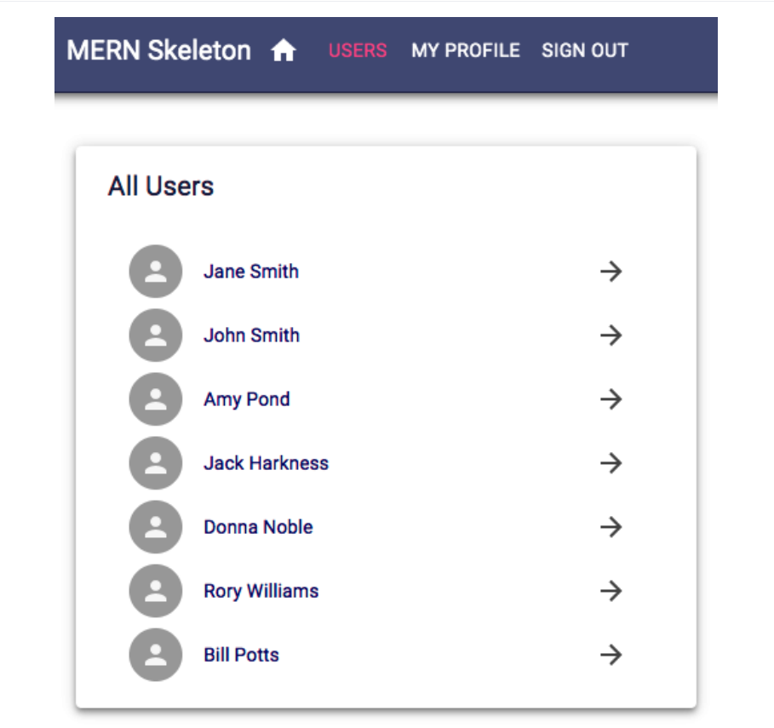
The Users component
The Users component in client/user/Users.jsx shows the names of all the users that have been fetched from the database and links each name to the user profile.
The following component can be viewed by any visitor to the application and will render at the '/users' route:

Slide 50
In the component definition, similar to how we implemented the Home component, we define and export a function component.
In this component, we start by initializing the state with an empty array of users.

Slide 51
mern-skeleton/client/user/Users.jsx:
export default function Users() {
//...
const [users, setUsers] = useState([])
//...
}

Slide 52
We are using the built-in React hook, useState, to add state to this function component.
By calling this hook, we are essentially declaring a state variable named users, which can be updated by invoking setUsers, and also set the initial value of users to [ ].
Using the built-in useState hook allows us to add state behavior to a function component in React.
Calling it will declare a state variable, similar to using this.state in class component definitions.
The argument that's passed to useState is the initial value of this variable – in other words, the initial state.

Slide 53
Invoking useState returns the current state and a function that updates the state value, which is similar to this.setState in a class definition.
With the users state initialized, next, we will use another built-in React hook named useEffect to fetch a list of users from the backend and update the users value in the state.
The Effect Hook, useEffect, serves the purpose of the componentDidMount, componentDidUpdate, and componentWillUnmount React life cycle methods that we would otherwise use in React classes.
Using this hook in a function component allows us to perform side effects such as fetching data from a backend.

Slide 54
By default, React runs the effects defined with useEffect after every render, including the first render.
But we can also instruct the effect to only rerun if something changes in state.
Optionally, we can also define how to clean up after an effect, for example, to perform an action such as aborting a fetch signal when the component unmounts to avoid memory leaks.
In our Users component, we use useEffect to call the list method from the api-user.js helper methods.
This will fetch the user list from the backend and load the user data into the component by updating the state.

Slide 55
mern-skeleton/client/user/Users.jsx:
useEffect(() => {
const abortController = new AbortController()const signal = abortController.signal
list(signal).then((data) => {
if (data && data.error) {
console.log(data.error)
} else {
setUsers(data)
}
})
return function cleanup(){
abortController.abort()
}
}, [])

Slide 56
Updated mern-skeleton/client/user/Users.jsx:
export default function Users() {
//...
const [users, setUsers] = useState([])
//...
}
useEffect(() => {
const abortController = new AbortController()const signal = abortController.signal
list(signal).then((data) => {
if (data && data.error) {
console.log(data.error)
} else {
setUsers(data)
}
})
return function cleanup(){
abortController.abort()
}
}, [])

Slide 57
In this effect, we also add a cleanup function to abort the fetch call when the component unmounts.
To associate a signal with the fetch call, we use the AbortController web API, which allows us to abort DOM requests as needed.
In the second argument of this useEffect hook, we pass an empty array so that this effect cleanup runs only once upon mounting and unmounting, and not after every render.
Finally, in the return of the Users function component, we add the actual view content.
The view is composed of Material-UI components such as Paper, List, and ListItem.
.

Slide 58
These elements are styled with the CSS that is defined and made available with the makeStyles hook, the same way as in the Home component

Slide 59
mern-skeleton/client/user/Users.js:
return (
<Paper className={classes.root} elevation={4}>
<Typography variant="h6" className={classes.title}>
All Users
</Typography>
<List dense>
{users.map((item, i) => {
return <Link to={"/user/" + item._id} key={i}>
<ListItem button>
<ListItemAvatar>
<Avatar>
<Person/>
</Avatar>
</ListItemAvatar>
<ListItemText primary={item.name}/>
<ListItemSecondaryAction>
<IconButton>
<ArrowForward/>
</IconButton>
</ListItemSecondaryAction>
</ListItem>
</Link>
})}
</List>
</Paper>
)

Slide 60
Updated mern-skeleton/client/user/Users.jsx:
export default function Users() {
//...
const [users, setUsers] = useState([])
//...
}
useEffect(() => {
const abortController = new AbortController()const signal = abortController.signal
list(signal).then((data) => {
if (data && data.error) {
console.log(data.error)
} else {
setUsers(data)
}
})
return function cleanup(){
abortController.abort()
}
}, [])
return (
<Paper className={classes.root} elevation={4}>
<Typography variant="h6" className={classes.title}>
All Users
</Typography>
<List dense>
{users.map((item, i) => {
return <Link to={"/user/" + item._id} key={i}>
<ListItem button>
<ListItemAvatar>
<Avatar>
<Person/>
</Avatar>
</ListItemAvatar>
<ListItemText primary={item.name}/>
<ListItemSecondaryAction>
<IconButton>
<ArrowForward/>
</IconButton>
</ListItemSecondaryAction>
</ListItem>
</Link>
})}
</List>
</Paper>
)

Slide 61
In this view, to generate each list item, we iterate through the array of users in the state using the map function.
A list item is rendered with an individual user's name from each item that's accessed per iteration on the users array.
To add this Users component to the React application, we need to update the MainRouter component with a Route that renders this component at the '/users' path.
Add the Route inside the Switch component after the Home route.

Slide 62
mern-skeleton/client/MainRouter.jsx:
<Route path="/users" component={Users}/>

Slide 63
This can be removed added scripts from this slide can be reviewed

Slide 64
Updated MainRouter.jsx
import React, { Component } from 'react'
import { Route, Redirect } from 'react-router-dom'
import auth from './auth-helper'
const PrivateRoute = ({ component: Component, ...rest }) => (
<Route {...rest} render={props => (
auth.isAuthenticated() ? (
<Component {...props}/>
) : (
<Redirect to={{
pathname: '/signin',
state: { from: props.location }
}}/>
)
)}/>
)
export default PrivateRoute

Slide 65
Updated Users.jsx
import React from 'react'
import useState from 'react'
import useStyles from 'react'
import useEffect from 'react'
import { makeStyles } from '@material-ui/core/styles'
import Card from '@material-ui/core/Card'
import Paper from '@material-ui/core/Paper'
import List from '@material-ui/core/List'
import list from './api-user.js'
import Link from '@material-ui/core/Link'
import ListItem from '@material-ui/core/ListItem'
import ListItemAvatar from '@material-ui/core/ListItemAvatar'
import ListItemText from '@material-ui/core/ListItemText'
import ListItemSecondaryAction from '@material-ui/core/ListItemSecondaryAction'
import IconButton from '@material-ui/core/IconButton'
import Avatar from '@material-ui/core/Avatar'
//import Person from '@material-ui/core/Person'
import ArrowForward from '@material-ui/core/ArrowForward'
import CardContent from '@material-ui/core/CardContent'
import CardMedia from '@material-ui/core/CardMedia'
import Typography from '@material-ui/core/Typography'
import unicornbikeImg from './../assets/images/unicornbikeImg.jpg'
export default function Users() {
useEffect(() => {
const abortController = new AbortController()
const signal = abortController.signal
list(signal).then((data) => {
if (data && data.error) {
console.log(data.error)
} else {
setUsers(data)
}
})
return function cleanup(){
abortController.abort()
}
}, [])
const [users, setUsers] = useState([])
const classes = useStyles()
return (
<Paper className={classes.root} elevation={4}>
<Typography variant="h6" className={classes.title}>
All Users
</Typography>
<List dense>
{users.map((item, i) => {
return <Link to={"/user/" + item._id} key={i}>
<ListItem button>
<ListItemAvatar>
<Avatar>
</Avatar>
</ListItemAvatar>
<ListItemText primary={item.name}/>
<ListItemSecondaryAction>
<IconButton>
<ArrowForward/>
</IconButton>
</ListItemSecondaryAction>
</ListItem>
</Link>
})}
</List>
</Paper>
)
}

Slide 66
Updated PrivateRoute.js
import React, { Component } from 'react'
import { Route, Redirect } from 'react-router-dom'
import auth from './auth-helper'
const PrivateRoute = ({ component: Component, ...rest }) => (
<Route {...rest} render={props => (
auth.isAuthenticated() ? (
<Component {...props}/>
) : (
<Redirect to={{
pathname: '/signin',
state: { from: props.location }
}}/>
)
)}/>
)
export default PrivateRoute

Slide 67
Updated auth-helper.js
authenticate(jwt, cb) {
if(typeof window !== "undefined")
sessionStorage.setItem('jwt', JSON.stringify(jwt))
cb()
}
isAuthenticated() {
if (typeof window == "undefined")
return false
if (sessionStorage.getItem('jwt'))
return JSON.parse(sessionStorage.getItem('jwt'))
else
return false
}
clearJWT(cb) {
if(typeof window !== "undefined")
sessionStorage.removeItem('jwt')
cb()
signout().then((data) => {
document.cookie = "t=; expires=Thu, 01 Jan 1970 00:00:00 UTC; path=/;"
})
}

Slide 68
To see this view rendered in the browser, you can temporarily add
a Link component to the Home component to be able to route to
the Users component:
<Link to="/users">Users</Link>
Clicking on this link after rendering the Home view at the root route in the browser
will display the Users component we implemented in this section. We will
implement the other React components similarly, starting with
the Signup component in the next section.

Slide 69
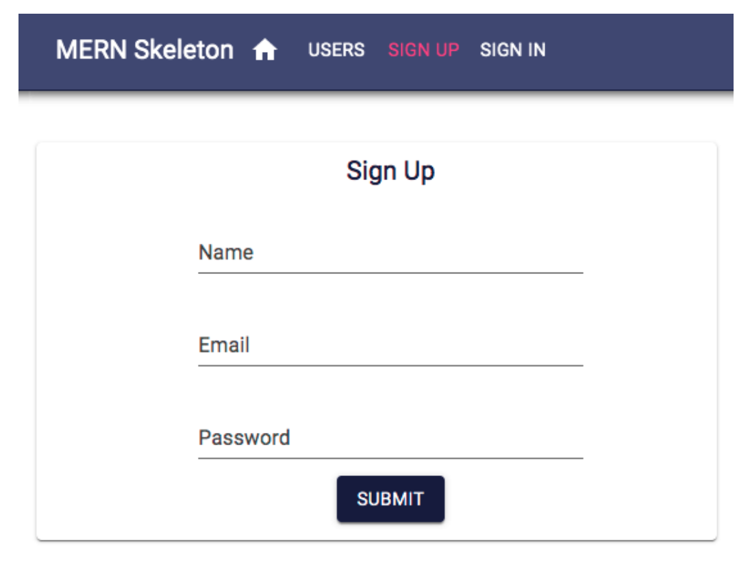
The Signup component
The Signup component in client/user/Signup.js presents a form with name, email, and password fields to the user for sign-up at the '/signup' path, as displayed in the following screenshot:

Slide 70
In the component definition, we initialize the state using the useState hook with empty input field values, an empty error message, and set the dialog open variable to false.

Slide 71
mern-skeleton/client/user/Signup.jsx:
export default function Signup() {
...
const [values, setValues] = useState({
name: '',
password: '',
email: '',
open: false,error: ''
})
...
}

Slide 72
We also define two handler functions to be called when the input values change or the submit button is clicked.
The handleChange function takes the new value that's entered in the input field and sets it as the state.

Slide 73
mern-skeleton/client/user/Signup.jsx:
const handleChange = name => event => {
setValues({ ...values, [name]: event.target.value })
}
The clickSubmit function is called when the form is submitted. It takes the input values from the state and calls the create fetch method to sign up the user with the backend.
Then, depending on the response from the server, either an error message is shown or a success dialog is shown.

Slide 74
mern-skeleton/client/user/Signup.jsx:
const clickSubmit = () => {
const user = {
name: values.name || undefined,
email: values.email || undefined,
password: values.password || undefined
}
create(user).then((data) => {
if (data.error) {
setValues({ ...values, error: data.error})
} else {
setValues({ ...values, error: '', open: true})
}
})
}

Slide 75
Updated mern-skeleton/client/user/Signup.jsx:
export default function Signup() {
...
const [values, setValues] = useState({
name: '',
password: '',
email: '',
open: false,error: ''
})
const handleChange = name => event => {
setValues({ ...values, [name]: event.target.value })
}
}
const clickSubmit = () => {
const user = {
name: values.name || undefined,
email: values.email || undefined,
password: values.password || undefined
}
create(user).then((data) => {
if (data.error) {
setValues({ ...values, error: data.error})
} else {
setValues({ ...values, error: '', open: true})
}
})
}

Slide 76
In the return function, we compose and style the form components in the signup view using components such as TextField from Material-UI.

Slide 77
mern-skeleton/client/user/Signup.jsx:
return (
<div>
<Card className={classes.card}>
<CardContent>
<Typography variant="h6" className={classes.title}>
Sign Up
</Typography>
<TextField id="name" label="Name"
className={classes.textField}value={values.name} onChange={handleChange('name')}
margin="normal"/>
<br/>
<TextField id="email" type="email" label="Email"
className={classes.textField}
value={values.email} onChange={handleChange('email')}
margin="normal"/>
<br/>
<TextField id="password" type="password" label="Password"
className={classes.textField} value={values.password}
onChange={handleChange('password')} margin="normal"/>
<br/>
{
values.error && (<Typography component="p" color="error">
)
<Icon color="error" className={classes.error}>error</Icon>
{values.error}</Typography>)
}
</CardContent>
<CardActions>
<Button color="primary" variant="contained" onClick={clickSubmit}
className={classes.submit}>Submit</Button>
</CardActions>
</Card>
</div>

Slide 78
Updated mern-skeleton/client/user/Signup.jsx:
export default function Signup() {
...
const [values, setValues] = useState({
name: '',
password: '',
email: '',
open: false,error: ''
})
const handleChange = name => event => {
setValues({ ...values, [name]: event.target.value })
}
}
const clickSubmit = () => {
const user = {
name: values.name || undefined,
email: values.email || undefined,
password: values.password || undefined
}
create(user).then((data) => {
if (data.error) {
setValues({ ...values, error: data.error})
} else {
setValues({ ...values, error: '', open: true})
}
})
}
return (
<div>
<Card className={classes.card}>
<CardContent>
<Typography variant="h6" className={classes.title}>
Sign Up
</Typography>
<TextField id="name" label="Name"
className={classes.textField}value={values.name} onChange={handleChange('name')}
margin="normal"/>
<br/>
<TextField id="email" type="email" label="Email"
className={classes.textField}
value={values.email} onChange={handleChange('email')}
margin="normal"/>
<br/>
<TextField id="password" type="password" label="Password"
className={classes.textField} value={values.password}
onChange={handleChange('password')} margin="normal"/>
<br/>
{
values.error && (<Typography component="p" color="error">
)
<Icon color="error" className={classes.error}>error</Icon>
{values.error}</Typography>)
}
</CardContent>
<CardActions>
<Button color="primary" variant="contained" onClick={clickSubmit}
className={classes.submit}>Submit</Button>
</CardActions>
</Card>
</div>
)

Slide 79
This return also contains an error message block, along with a Dialog component that is conditionally rendered depending on the signup response from the server.
If the server returns an error, the error block that was added below the form, which we implemented in the preceding code, will render in the view with the corresponding error message.
If the server returns a successful response, a Dialog component will be rendered instead.
The Dialog component in Signup.js is composed as follows.

Slide 80
mern-skeleton/client/user/Signup.jsx:
<Dialog open={values.open} disableBackdropClick={true}>
<DialogTitle>New Account</DialogTitle>
<DialogContent>
<DialogContentText>
New account successfully created.
</DialogContentText>
</DialogContent>
<DialogActions>
<Link to="/signin">
<Button color="primary" autoFocus="autoFocus"
variant="contained">
Sign In
</Button>
</Link>
</DialogActions>
</Dialog>

Slide 81
Updated mern-skeleton/client/user/Signup.jsx:
/*export default function Signup() {
...
const [values, setValues] = useState({
name: '',
password: '',
email: '',
open: false,error: ''
})
const handleChange = name => event => {
setValues({ ...values, [name]: event.target.value })
}
}
const clickSubmit = () => {
const user = {
name: values.name || undefined,
email: values.email || undefined,
password: values.password || undefined
}
create(user).then((data) => {
if (data.error) {
setValues({ ...values, error: data.error})
} else {
setValues({ ...values, error: '', open: true})
}
})
}
return (
<div>
<Card className={classes.card}>
<CardContent>
<Typography variant="h6" className={classes.title}>
Sign Up
</Typography>
<TextField id="name" label="Name"
className={classes.textField}value={values.name} onChange={handleChange('name')}
margin="normal"/>
<br/>
<TextField id="email" type="email" label="Email"
className={classes.textField}
value={values.email} onChange={handleChange('email')}
margin="normal"/>
<br/>
<TextField id="password" type="password" label="Password"
className={classes.textField} value={values.password}
onChange={handleChange('password')} margin="normal"/>
<br/>
{
values.error && (<Typography component="p" color="error">
)
<Icon color="error" className={classes.error}>error</Icon>
{values.error}</Typography>)
}
</CardContent>
<CardActions>
<Button color="primary" variant="contained" onClick={clickSubmit}
className={classes.submit}>Submit</Button>
</CardActions>
</Card>
</div>
)
<Dialog open={values.open} disableBackdropClick={true}>
<DialogTitle>New Account</DialogTitle>
<DialogContent>
<DialogContentText>
New account successfully created.
</DialogContentText>
</DialogContent>
<DialogActions>
<Link to="/signin">
<Button color="primary" autoFocus="autoFocus"
variant="contained">
Sign In
</Button>
</Link>
</DialogActions>
</Dialog>*/
import React, { useState } from 'react';
import { makeStyles } from '@material-ui/core/styles'
import { Card, CardContent, Typography, TextField, CardActions, Button, Dialog, DialogTitle, DialogContent, DialogContentText, DialogActions, Icon } from '@material-ui/core';
import { Link } from 'react-router-dom';
// Define your CSS classes using a styling library like Material-UI
const useStyles = makeStyles(theme => ({
card: {
// Define your card styles here
},
textField: {
// Define your text field styles here
},
error: {
// Define your error icon styles here
},
submit: {
// Define your submit button styles here
},
title: {
// Define your title styles here
},
}));
// Mock create function, replace this with your actual implementation
const create = async (user) => {
// Simulate an API call or database operation
// Return a response object, for example:
return { error: null };
};
export default function Signup() {
const classes = useStyles();
const [values, setValues] = useState({
name: '',
password: '',
email: '',
open: false,
error: ''
});
const handleChange = name => event => {
setValues({ ...values, [name]: event.target.value });
};
const clickSubmit = () => {
const user = {
name: values.name || undefined,
email: values.email || undefined,
password: values.password || undefined
};
create(user).then((data) => {
if (data.error) {
setValues({ ...values, error: data.error });
} else {
setValues({ ...values, error: '', open: true });
}
});
};
return (
<div>
<Card className={classes.card}>
<CardContent>
<Typography variant="h6" className={classes.title}>
Sign Up
</Typography>
<TextField id="name" label="Name"
className={classes.textField} value={values.name} onChange={handleChange('name')}
margin="normal"
/>
{/* Other input fields */}
{/* Error message */}
</CardContent>
<CardActions>
<Button color="primary" variant="contained" onClick={clickSubmit}
className={classes.submit}>
Submit
</Button>
</CardActions>
</Card>
<Dialog open={values.open} disableBackdropClick={true}>
<DialogTitle>New Account</DialogTitle>
<DialogContent>
<DialogContentText>
New account successfully created.
</DialogContentText>
</DialogContent>
<DialogActions>
<Link to="/signin">
<Button color="primary" autoFocus variant="contained">
Sign In
</Button>
</Link>
</DialogActions>
</Dialog>
</div>
);
}

Slide 82
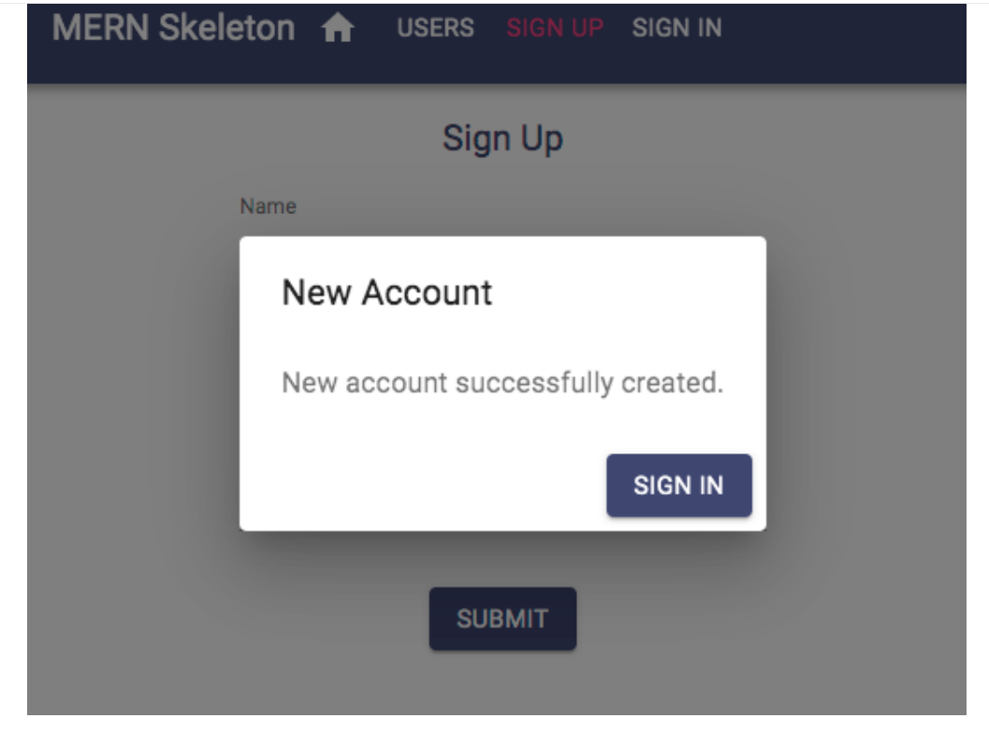
On successful account creation, the user is given confirmation and asked to sign in using this Dialog component, which links to the Signin component, as shown in the following screenshot:

Slide 83
To add the Signup component to the app, add the following Route to MainRouter in the Switch component.

Slide 84
mern-skeleton/client/MainRouter.jsx:
<Route path="/signup" component={Signup}/>

Slide 85
Updated mern-skeleton/client/MainRouter.jsx:
import React from 'react'
import {Route, Routes} from 'react-router-dom'
import Home from './core/Home'
import Users from './user/Users.jsx'
import Signup from './user/Signup.jsx'
const MainRouter = () => {
return ( <div>
<Routes>
<Route exact path="/" element={<Home />} />
<Route path="/users" component={Users} />
<Route path="/signup" component={Signup}/>
</Routes>
</div>
)
}
export default MainRouter

Slide 86
This will render the Signup view at '/signup'. Similarly, we will implement the Signin component next.

Slide 87
The Signin component
The Signin component in client/auth/Signin.js is also a form with only email and password fields for signing in.
This component is quite similar to the Signup component and will render at the '/signin' path.
The key difference is in the implementation of redirection after a successful sign-in and storing the received JWT credentials.
The rendered Signin component can be seen in the following screenshot:

Slide 88
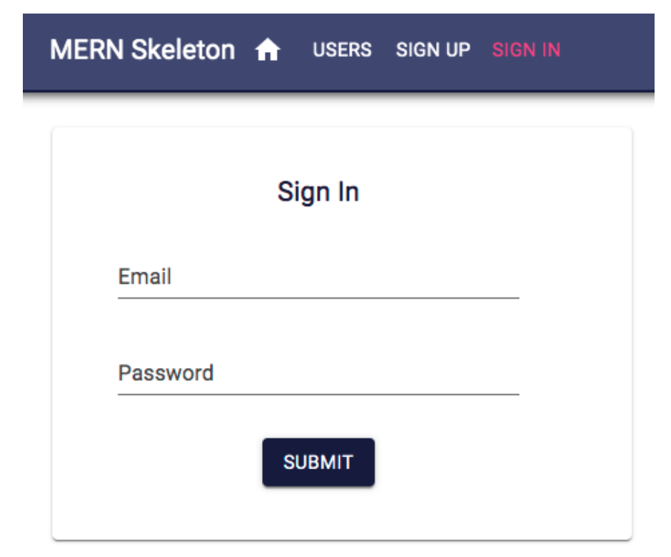

Slide 89
For redirection, we will use the Redirect component from React Router. First, initialize a redirectToReferrer value to false in the state with the other fields:
mern-skeleton/client/auth/Signin.js:
/*export default function Signin(props) {
const [values, setValues] = useState({
email: '',
password: '',
error: '',redirectToReferrer: false
})
}*/
import React, { useState } from 'react';
export default function Signin(props) {
const [values, setValues] = useState({
email: '',
password: '',
error: '',
redirectToReferrer: false
});
// Rest of your component logic
}

Slide 90
The Signin function will take props in the argument that contain React Router variables.
We will use these for the redirect. redirectToReferrer should be set to true when the user successfully signs in after submitting the form and the received JWT is stored in sessionStorage.
To store the JWT and redirect afterward, we will call the authenticate() method defined in auth-helper.js.
This implementation will go in the clickSubmit() function so that it can be called on form submit.

Slide 91
mern-skeleton/client/auth/Signin.js:
const clickSubmit = () => {
const user = {
email: values.email || undefined,
password: values.password || undefined
}
signin(user).then((data) => {
if (data.error) {
setValues({ ...values, error: data.error})
} else {
auth.authenticate(data, () => {
setValues({ ...values, error: '',redirectToReferrer: true})
})
}
})
}

Slide 92
Updated mern-skeleton/client/auth/Signin.js:
import React, { useState } from 'react';
export default function Signin(props) {
const [values, setValues] = useState({
email: '',
password: '',
error: '',
redirectToReferrer: false
});
const clickSubmit = () => {
const user = {
email: values.email || undefined,
password: values.password || undefined
};
// Assuming `signin` and `auth.authenticate` are defined somewhere in your code
Signin(user).then((data) => {
if (data.error) {
setValues({ ...values, error: data.error });
} else {
auth.authenticate(data, () => {
setValues({ ...values, error: '', redirectToReferrer: true });
});
}
});
};
// Rest of your component logic
return (
// Your JSX components and elements go here
);
}

Slide 93
The redirection will happen conditionally based on the redirectToReferrer value using the Redirect component from React Router.
We add the redirect code inside the function before the return block, as follows.
mern-skeleton/client/auth/Signin.js:
const {from} = props.location.state || {
from: {
pathname: '/'
}
}
const {redirectToReferrer} = values
if (redirectToReferrer) {
return (<Redirect to={from}/>)
}

Slide 94
Updated mern-skeleton/client/auth/Signin.js:
import React, { useState } from 'react';
export default function Signin(props) {
const [values, setValues] = useState({
email: '',
password: '',
error: '',
redirectToReferrer: false
});
const clickSubmit = () => {
const user = {
email: values.email || undefined,
password: values.password || undefined
};
// Assuming `signin` and `auth.authenticate` are defined somewhere in your code
Signin(user).then((data) => {
if (data.error) {
setValues({ ...values, error: data.error });
} else {
auth.authenticate(data, () => {
setValues({ ...values, error: '', redirectToReferrer: true });
});
}
});
};
// Rest of your component logic
return (
// Your JSX components and elements go here
);
}
const {from} = props.location.state || {
from: {
pathname: '/'
}
}
const {redirectToReferrer} = values
if (redirectToReferrer) {
return (<Redirect to={from}/>)
}

Slide 95
The Redirect component, if rendered, will take the app to the last location that was received in the props or to the Home component at the root.
The function return code is not displayed here as it is very similar to the code in Signup.
It will contain the same form elements withjust email and password fields, a conditional error message, and the submit button.
To add the Signin component to the app, add the following Route to MainRouter in the Switch component.

Slide 96
mern-skeleton/client/MainRouter.jsx:
<Route path="/signin" component={Signin}/>

Slide 97
Updated mern-skeleton/client/MainRouter.jsx:
import React from 'react'
import {Route, Routes} from 'react-router-dom'
import Home from './core/Home'
import Users from './user/Users.jsx'
import Signup from './user/Signup.jsx'
import Signin from './auth/Signin.js'
const MainRouter = () => {
return ( <div>
<Routes>
<Route exact path="/" element={<Home />} />
<Route path="/users" component={Users} />
<Route path="/signup" component={Signup} />
<Route path="/signin" component={Signin}/>
</Routes>
</div>
)
}
export default MainRouter

Slide 98
This will render the Signin component at "/signin" and can be linked in the Home component, similar to the Signup component, so that it can be viewed in the browser.
Next, we will implement the profile view to display the details of a single user.

Slide 99
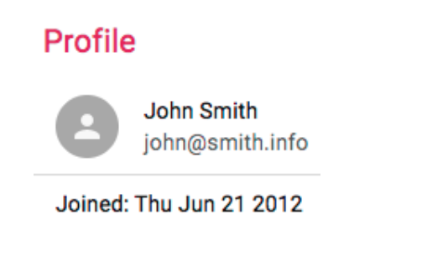
The Profile component
The Profile component in client/user/Profile.js shows a single user's information in the view at the '/user/:userId' path, where the userId parameter represents the ID of the specific user.
The completed Profile will display user details, and also conditionally show edit/delete options.
The following screenshot shows how the Profile renders when the user currently browsing is viewing someone else's profile and not their own profile:

Slide 100
This profile information can be fetched from the server if the user is signed in.
To verify this, the component has to provide the JWT credential to the read fetch call; otherwise, the user should be redirected to the Sign In view.
In the Profile component definition, we need to initialize the state with an empty user and set redirectToSignin to false.

Slide 101
mern-skeleton/client/user/Profile.js:
export default function Profile({ match }) {
...
const [user, setUser] = useState({})
const [redirectToSignin, setRedirectToSignin] = useState(false)
...
}

Slide 102
We also need to get access to the match props passed by the Route component, which will contain a :userId parameter value.
This can be accessed as match.params.userId.
The Profile component should fetch user information and render the view with these details.
To implement this, we will use the useEffect hook, as we did in the Users component.

Slide 103
mern-skeleton/client/user/Profile.js:
useEffect(() => {
const abortController = new AbortController()
const signal = abortController.signal
const jwt = auth.isAuthenticated()
read({
userId: match.params.userId
}, {t: jwt.token}, signal).then((data) => {
if (data && data.error) {
setRedirectToSignin(true)
} else {
setUser(data)
}
})
return function cleanup(){
abortController.abort()
}
}, [match.params.userId])

Slide 104
Updated mern-skeleton/client/user/Profile.js:
//import React, { useState } from 'react';
import auth from './auth/auth-helper.js';
import React, { useState } from 'react';
import useState from 'react'
import read from 'react';
import match from 'react';
import setUser from 'react';
import setRedirectToSignin from 'react';
export default function Profile({ match }) {
//...
const [user, setUser] = useState({})
const [redirectToSignin, setRedirectToSignin] = useState(false)
//...
}
useEffect(() => {
const abortController = new AbortController()
const signal = abortController.signal
const jwt = auth.isAuthenticated()
read({
userId: match.params.userId
}, {t: jwt.token}, signal).then((data) => {
if (data && data.error) {
setRedirectToSignin(true)
} else {
setUser(data)
}
})
return function cleanup(){
abortController.abort()
}
}, [match.params.userId])

Slide 105
This effect uses the match.params.userId value and calls the read user fetch method.
Since this method also requires credentials to authorize the signed-in user, the JWT is retrieved from sessionStorage using the isAuthenticated method from auth-helper.js, and passed in the call to read.
Once the server responds, either the state is updated with the user information or the view is redirected to the Sign In view if the current user is not authenticated.

Slide 106
We also add a cleanup function in this effect hook to abort the fetch signal when the component unmounts.
This effect only needs to rerun when the userId parameter changes in the route, for example, when the app goes from one profile view to the other.
To ensure this effect reruns when the userId value updates, we will add [match.params.userId] in the second argument to useEffect.
If the current user is not authenticated, we set up the conditional redirect to the Sign In view.

Slide 107
mern-skeleton/client/user/Profile.js
if (redirectToSignin) {
return <Redirect to='/signin'/>
}

Slide 108
Updated mern-skeleton/client/user/Profile.js
//import React, { useState } from 'react';
import auth from './auth/auth-helper.js';
import React, { useState,useEffect } from 'react';
import { Redirect } from 'react-router-dom';
import { read } from './someApiModule'; // Replace with the actual module that contains the read function
//import useState from 'react'
import read from 'react';
import match from 'react';
import setUser from 'react';
import setRedirectToSignin from 'react';
export default function Profile({ match }) {
//...
const [user, setUser] = useState({})
const [redirectToSignin, setRedirectToSignin] = useState(false)
//...
}
useEffect(() => {
const abortController = new AbortController()
const signal = abortController.signal
const jwt = auth.isAuthenticated()
read({
userId: match.params.userId
}, {t: jwt.token}, signal).then((data) => {
if (data && data.error) {
setRedirectToSignin(true)
} else {
setUser(data)
}
})
return function cleanup(){
abortController.abort()
}
}, [match.params.userId])
if (redirectToSignin) {
return <Redirect to='/signin'/>
}
return (
<Paper className={classes.root} elevation={4}>
<Typography variant="h6" className={classes.title}>
Profile
</Typography>
<List dense>
<ListItem>
<ListItemAvatar>
<Avatar>
<Person/>
</Avatar>
</ListItemAvatar>
<ListItemText primary={user.name} secondary={user.email}/>
</ListItem>
<Divider/>
<ListItem>
<ListItemText primary={"Joined: " + (
new Date(user.created)).toDateString()}/>
</ListItem>
</List>
</Paper>
)

Slide 109
The function will return the Profile view with the following elements if the user who's currently signed in is viewing another user's profile.

Slide 110
mern-skeleton/client/user/Profile.js:
return (
<Paper className={classes.root} elevation={4}>
<Typography variant="h6" className={classes.title}>
Profile
</Typography>
<List dense>
<ListItem>
<ListItemAvatar>
<Avatar>
<Person/>
</Avatar>
</ListItemAvatar>
<ListItemText primary={user.name} secondary={user.email}/>
</ListItem>
<Divider/>
<ListItem>
<ListItemText primary={"Joined: " + (
new Date(user.created)).toDateString()}/>
</ListItem>
</List>
</Paper>
)

Slide 111
updated mern-skeleton/client/user/Profile.js
//import React, { useState } from 'react';
import auth from './auth/auth-helper.js';
import React, { useState,useEffect } from 'react';
import { Redirect } from 'react-router-dom';
import { read } from './someApiModule'; // Replace with the actual module that contains the read function
//import useState from 'react'
import read from 'react';
import match from 'react';
import setUser from 'react';
import setRedirectToSignin from 'react';
export default function Profile({ match }) {
//...
const [user, setUser] = useState({})
const [redirectToSignin, setRedirectToSignin] = useState(false)
//...
}
useEffect(() => {
const abortController = new AbortController()
const signal = abortController.signal
const jwt = auth.isAuthenticated()
read({
userId: match.params.userId
}, {t: jwt.token}, signal).then((data) => {
if (data && data.error) {
setRedirectToSignin(true)
} else {
setUser(data)
}
})
return function cleanup(){
abortController.abort()
}
}, [match.params.userId])
if (redirectToSignin) {
return <Redirect to='/signin'/>
}
return (
<Paper className={classes.root} elevation={4}>
<Typography variant="h6" className={classes.title}>
Profile
</Typography>
<List dense>
<ListItem>
<ListItemAvatar>
<Avatar>
<Person/>
</Avatar>
</ListItemAvatar>
<ListItemText primary={user.name} secondary={user.email}/>
</ListItem>
<Divider/>
<ListItem>
<ListItemText primary={"Joined: " + (
new Date(user.created)).toDateString()}/>
</ListItem>
</List>
</Paper>
)

Slide 112
Updated mern-skeleton/client/user/Profile.js
//import React, { useState } from 'react';
import auth from './auth/auth-helper.js';
import React, { useState,useEffect } from 'react';
import { Redirect } from 'react-router-dom';
import { read } from './someApiModule'; // Replace with the actual module that contains the read function
//import useState from 'react'
import read from 'react';
import match from 'react';
import setUser from 'react';
import setRedirectToSignin from 'react';
export default function Profile({ match }) {
//...
const [user, setUser] = useState({})
const [redirectToSignin, setRedirectToSignin] = useState(false)
//...
}
useEffect(() => {
const abortController = new AbortController()
const signal = abortController.signal
const jwt = auth.isAuthenticated()
read({
userId: match.params.userId
}, {t: jwt.token}, signal).then((data) => {
if (data && data.error) {
setRedirectToSignin(true)
} else {
setUser(data)
}
})
return function cleanup(){
abortController.abort()
}
}, [match.params.userId])
if (redirectToSignin) {
return <Redirect to='/signin'/>
}
return (
<Paper className={classes.root} elevation={4}>
<Typography variant="h6" className={classes.title}>
Profile
</Typography>
<List dense>
<ListItem>
<ListItemAvatar>
<Avatar>
<Person/>
</Avatar>
</ListItemAvatar>
<ListItemText primary={user.name} secondary={user.email}/>
</ListItem>
<Divider/>
<ListItem>
<ListItemText primary={"Joined: " + (
new Date(user.created)).toDateString()}/>
</ListItem>
</List>
</Paper>
)

Slide 113
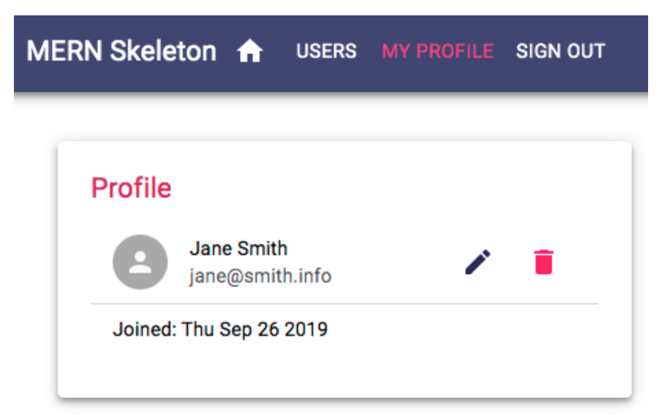
However, if the user that's currently signed in is viewing their own profile, they will be able to see edit and delete options in the Profile component, as shown in the following screen shot:

Slide 114
To implement this feature, in the first ListItem component in the Profile, add a ListItemSecondaryAction component containing the Edit button and a DeleteUser component, which will render conditionally based on whether the current user is viewing their own profile.

Slide 115
mern-skeleton/client/user/Profile.js:
{ auth.isAuthenticated().user && auth.isAuthenticated().user._id == user._id &&
(<ListItemSecondaryAction>
<Link to={"/user/edit/" + user._id}>
<IconButton aria-label="Edit" color="primary">
<Edit/>
</IconButton>
</Link>
<DeleteUser userId={user._id}/>
</ListItemSecondaryAction>)
}

Slide 116
Updated mern-skeleton/client/user/Profile.js:
//import React, { useState } from 'react';
import auth from './auth/auth-helper.js';
import React, { useState,useEffect } from 'react';
import { Redirect } from 'react-router-dom';
import { read } from './someApiModule'; // Replace with the actual module that contains the read function
//import useState from 'react'
import read from 'react';
import match from 'react';
import setUser from 'react';
import setRedirectToSignin from 'react';
export default function Profile({ match }) {
//...
const [user, setUser] = useState({})
const [redirectToSignin, setRedirectToSignin] = useState(false)
//...
}
useEffect(() => {
const abortController = new AbortController()
const signal = abortController.signal
const jwt = auth.isAuthenticated()
read({
userId: match.params.userId
}, {t: jwt.token}, signal).then((data) => {
if (data && data.error) {
setRedirectToSignin(true)
} else {
setUser(data)
}
})
return function cleanup(){
abortController.abort()
}
}, [match.params.userId])
if (redirectToSignin) {
return <Redirect to='/signin'/>
}
return (
<Paper className={classes.root} elevation={4}>
<Typography variant="h6" className={classes.title}>
Profile
</Typography>
<List dense>
<ListItem>
<ListItemAvatar>
<Avatar>
<Person/>
</Avatar>
</ListItemAvatar>
<ListItemText primary={user.name} secondary={user.email}/>
</ListItem>
<Divider/>
<ListItem>
<ListItemText primary={"Joined: " + (
new Date(user.created)).toDateString()}/>
</ListItem>
</List>
</Paper>
)
{ auth.isAuthenticated().user && auth.isAuthenticated().user._id == user._id &&
(<ListItemSecondaryAction>
<Link to={"/user/edit/" + user._id}>
<IconButton aria-label="Edit" color="primary">
<Edit/>
</IconButton>
</Link>
<DeleteUser userId={user._id}/>
</ListItemSecondaryAction>)
}

Slide 117
The Edit button will route to the EditProfile component, while the custom DeleteUser component will handle the delete operation with the userId passed to it as a prop.
To add the Profile component to the app, add the Route to MainRouter in the Switch component.

Slide 118
mern-skeleton/client/MainRouter.jsx:
<Route path="/user/:userId" component={Profile}/>

Slide 119
Updated mern-skeleton/client/MainRouter.jsx:
import React from 'react'
import {Route, Routes} from 'react-router-dom'
import Home from './core/Home'
import Users from './user/Users.jsx'
import Signup from './user/Signup.jsx'
import Signin from './auth/Signin.js'
import Profile from './user/Profile.js'
const MainRouter = () => {
return ( <div>
<Routes>
<Route exact path="/" element={<Home />} />
<Route path="/users" component={Users} />
<Route path="/signup" component={Signup} />
<Route path="/signin" component={Signin} />
<Route path="/user/:userId" component={Profile}/>
</Routes>
</div>
)
}
export default MainRouter

Slide 120
To visit this route in the browser and render a Profile with user details, the link should be composed with a valid user ID in it. In the next section, we will use this same approach of retrieving single user details and rendering it in the component to implement the Edit Profile view.

Slide 121
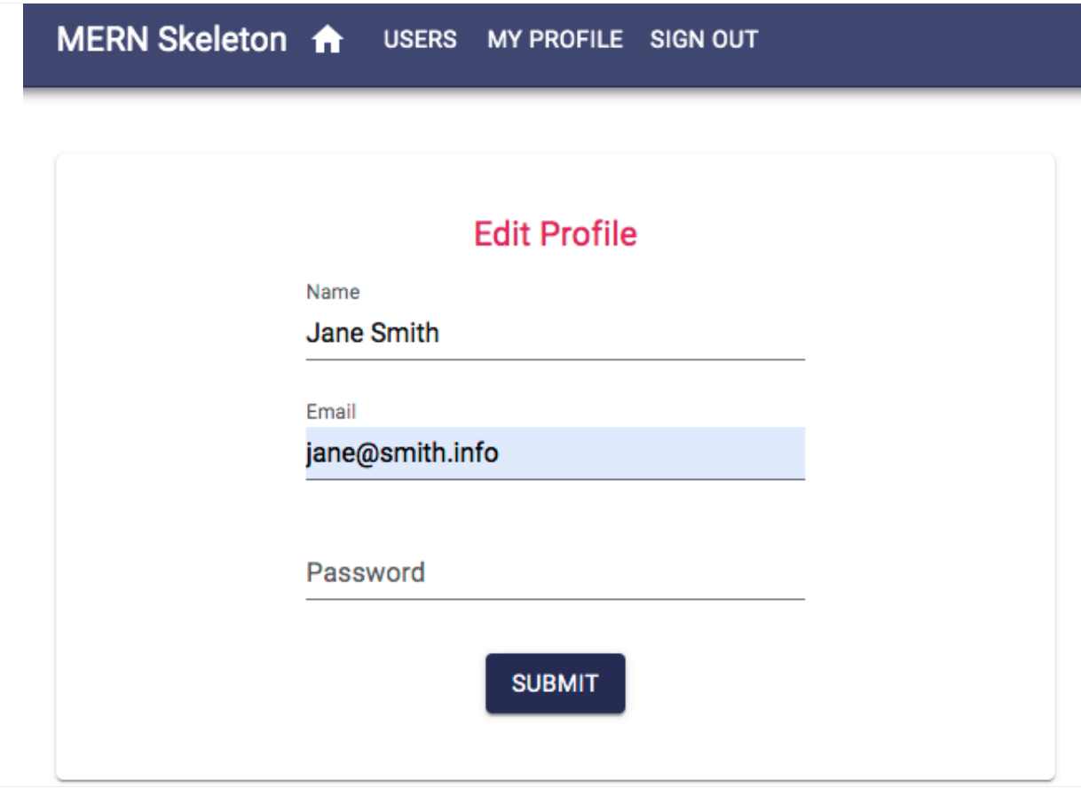
The EditProfile component
The EditProfile component in client/user/EditProfile.js has similarities in its implementation to both the Signup and Profile components.
It allows the authorized user to edit their own profile information in a form similar to the signup form, as shown in the following screenshot:

Slide 122
Upon loading at '/user/edit/:userId', the component will fetch the user's information with their ID after verifying JWT for auth, and then load the form with the received user information.
The form will allow the user to edit and submit only the changed information to the update fetch call, and, on successful update, redirect the user to the Profile view with updated information.
EditProfile will load the user information the same way as in the Profile component, that is, by fetching with read in useEffect using the userId parameter from match.params.
It will gather credentials from auth.isAuthenticated.

Slide 123
The form view will contain the same elements as the Signup component, with the input values being updated in the state when they change.
On form submit, the component will call the update fetch method with the userId, JWT and updated user data.

Slide 124
mern-skeleton/client/user/EditProfile.js:
const clickSubmit = () => {
const jwt = auth.isAuthenticated()
const user = {
name: values.name || undefined,
email: values.email || undefined,
password: values.password || undefined
}
update({
userId: match.params.userId
}, {
t: jwt.token
}, user).then((data) => {
if (data && data.error) {
setValues({...values, error: data.error})
} else {
setValues({...values, userId: data._id, redirectToProfile: true})
}
})
}

Slide 125
Updated mern-skeleton/client/user/EditProfile.js:
import auth from './auth/auth-helper.js';
import React, { useState,useEffect } from 'react';
import clickSubmit from 'react';
//import { read } from './someApiModule'; // Replace with the actual module that contains the read function
//import useState from 'react'
import read from 'react';
import match from 'react';
import setValues from 'react';
import setRedirectToSignin from 'react';
const clickSubmit = () => {
const jwt = auth.isAuthenticated()
const user = {
name: values.name || undefined,
email: values.email || undefined,
password: values.password || undefined
}
update({
userId: match.params.userId
}, {
t: jwt.token
}, user).then((data) => {
if (data && data.error) {
setValues({...values, error: data.error})
} else {
setValues({...values, userId: data._id, redirectToProfile: true})
}
})
}

Slide 126
Depending on the response from the server, the user will either see an error message or be redirected to the updated Profile page using the Redirect component, as follows.
mern-skeleton/client/user/EditProfile.js:
if (values.redirectToProfile) {
return (<Redirect to={'/user/' + values.userId}/>)
}

Slide 127
Updated mern-skeleton/client/user/EditProfile.js:
import auth from './auth/auth-helper.js';
import React, { useState,useEffect } from 'react';
import clickSubmit from 'react';
//import { read } from './someApiModule'; // Replace with the actual module that contains the read function
//import useState from 'react'
import read from 'react';
import match from 'react';
import setValues from 'react';
import setRedirectToSignin from 'react';
const clickSubmit = () => {
const jwt = auth.isAuthenticated()
const user = {
name: values.name || undefined,
email: values.email || undefined,
password: values.password || undefined
}
update({
userId: match.params.userId
}, {
t: jwt.token
}, user).then((data) => {
if (data && data.error) {
setValues({...values, error: data.error})
} else {
setValues({...values, userId: data._id, redirectToProfile: true})
}
})
}
if (values.redirectToProfile) {
return (<Redirect to={'/user/' + values.userId}/>)
}

Slide 128
To add the EditProfile component to the app, we will use a PrivateRoute, which will restrict the component from loading at all if the user is not signed in.
The order of placement in MainRouter will also be important.

Slide 129
mern-skeleton/client/MainRouter.jsx:
<Switch>
...
<PrivateRoute path="/user/edit/:userId" component={EditProfile}/>
<Route path="/user/:userId" component={Profile}/>
</Switch>

Slide 130
Updated mern-skeleton/client/MainRouter.jsx:
import React from 'react'
import {Route, Routes} from 'react-router-dom'
import Home from './core/Home'
import Users from './user/Users.jsx'
import Signup from './user/Signup.jsx'
import Signin from './auth/Signin.js'
import Profile from './user/Profile.js'
import Switch from 'react'
import PrivateRoute from 'react'
import EditProfile from 'react'
const MainRouter = () => {
return ( <div>
<Routes>
<Route exact path="/" element={<Home />} />
<Route path="/users" component={Users} />
<Route path="/signup" component={Signup} />
<Route path="/signin" component={Signin} />
<Route path="/user/:userId" component={Profile}/>
<Switch>
...
<PrivateRoute path="/user/edit/:userId" component={EditProfile}/>
<Route path="/user/:userId" component={Profile}/>
</Switch>
</Routes>
</div>
)
}
export default MainRouter

Slide 131
The route with the '/user/edit/:userId' path needs to be placed before the route with the '/user/:userId' path, so that the edit path is matched first exclusively in the Switch component when this route is requested, and not confused with the Profile route.
With this profile edit view added, we only have the user delete UI implementation left to complete the user-related frontend.

Slide 132
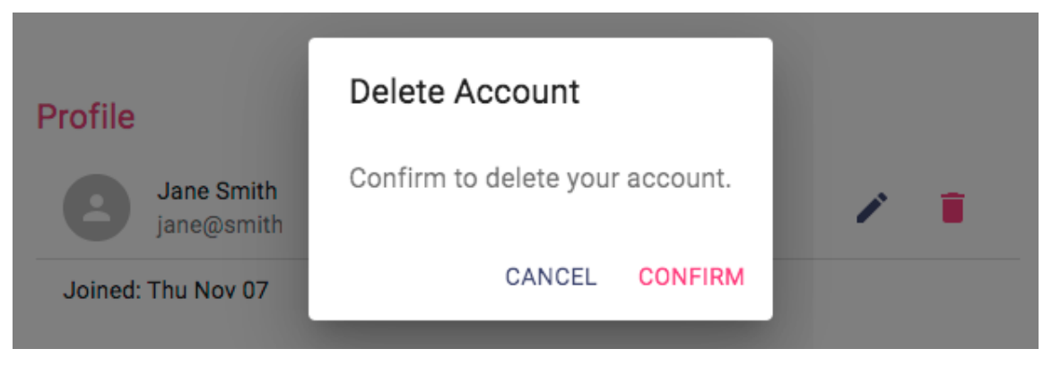
The DeleteUser component
The DeleteUser component in client/user/DeleteUser.js is basically a button that we will add to the Profile view that, when clicked, opens a Dialog component asking the user to confirm the delete action, as shown in the following screenshot:

Slide 133
This component initializes the state with open set to false forthe Dialog component, as well as redirect set to false so that it isn't rendered first.

Slide 134
mern-skeleton/client/user/DeleteUser.js:
export default function DeleteUser(props) {
...
const [open, setOpen] = useState(false)
const [redirect, setRedirect] = useState(false)
...
}

Slide 135
The DeleteUser component will also receive props from the parent component.
In this case, the props will contain the userId that was sent from the Profile component.
Next, we need some handler methods to open and close the dialog button.
The dialog is opened when the user clicks the delete button.

Slide 136
mern-skeleton/client/user/DeleteUser.js:
const clickButton = () => {
setOpen(true)
}
The dialog is closed when the user clicks cancel on the dialog.
const handleRequestClose = () => {
setOpen(false)
}

Slide 137
Updated mern-skeleton/client/user/DeleteUser.js:
import useState from 'react'
import setOpen from 'react'
export default function DeleteUser(props) {
//...
const [open, setOpen] = useState(false)
const [redirect, setRedirect] = useState(false)
//...
}
const clickButton = () => {
setOpen(true)
}
const handleRequestClose = () => {
setOpen(false)
}

Slide 138
The component will have access to the userId that's passed in as a prop from the Profile component, which is needed to call the remove fetch method, along with the JWT credentials, after the user confirms the delete action in the dialog.

Slide 139
mern-skeleton/client/user/DeleteUser.js:
const deleteAccount = () => {
const jwt = auth.isAuthenticated()
remove({
userId: props.userId
}, {t: jwt.token}).then((data) => {
if (data && data.error) {
console.log(data.error)
} else {
auth.clearJWT(() => console.log('deleted'))
setRedirect(true)
}
})
}

Slide 140
Updated mern-skeleton/client/user/DeleteUser.js:
import useState from 'react'
import setOpen from 'react'
import props from 'react'
import auth from './auth/auth-helper.js';
import setRedirect from 'react'
import remove from 'react'
export default function DeleteUser(props) {
//...
const [open, setOpen] = useState(false)
const [redirect, setRedirect] = useState(false)
//...
}
const clickButton = () => {
setOpen(true)
}
const handleRequestClose = () => {
setOpen(false)
}
const deleteAccount = () => {
const jwt = auth.isAuthenticated()
remove({
userId: props.userId
}, {t: jwt.token}).then((data) => {
if (data && data.error) {
console.log(data.error)
} else {
auth.clearJWT(() => console.log('deleted'))
setRedirect(true)
}
})
}

Slide 141
On confirmation, the deleteAccount function calls the remove fetch method with the userId from props and JWT from isAuthenticated.
On successful deletion, the user will be signed out and redirected to the Home view.
The Redirect component from React Router is used to redirect the current user to the Home view, as follows:
if (redirect) {
return <Redirect to='/'/>
}
The component function returns the DeleteUser component elements, including a DeleteIcon button and the confirmation Dialog.

Slide 142
mern-skeleton/client/user/DeleteUser.js:
return (<span>
<IconButton aria-label="Delete"
onClick={clickButton} color="secondary">
<DeleteIcon/>
</IconButton>
<Dialog open={open} onClose={handleRequestClose}>Cancel
<DialogTitle>{"Delete Account"}</DialogTitle>
<DialogContent>
<DialogContentText>
Confirm to delete your account.
</DialogContentText>
</DialogContent>
<DialogActions>
<Button onClick={handleRequestClose} color="primary">
</Button>
<Button onClick={deleteAccount}
color="secondary" autoFocus="autoFocus">
Confirm
</Button>
</DialogActions>
</Dialog>
</span>)

Slide 143
Updated mern-skeleton/client/user/DeleteUser.js:
import useState from 'react'
import setOpen from 'react'
import props from 'react'
import auth from './auth/auth-helper.js';
import setRedirect from 'react'
import remove from 'react'
import return from 'react'
export default function DeleteUser(props) {
//...
const [open, setOpen] = useState(false)
const [redirect, setRedirect] = useState(false)
//...
}
const clickButton = () => {
setOpen(true)
}
const handleRequestClose = () => {
setOpen(false)
}
const deleteAccount = () => {
const jwt = auth.isAuthenticated()
remove({
userId: props.userId
}, {t: jwt.token}).then((data) => {
if (data && data.error) {
console.log(data.error)
} else {
auth.clearJWT(() => console.log('deleted'))
setRedirect(true)
}
})
}
return (<span>
<IconButton aria-label="Delete"
onClick={clickButton} color="secondary">
<DeleteIcon/>
</IconButton>
<Dialog open={open} onClose={handleRequestClose}>Cancel
<DialogTitle>{"Delete Account"}</DialogTitle>
<DialogContent>
<DialogContentText>
Confirm to delete your account.
</DialogContentText>
</DialogContent>
<DialogActions>
<Button onClick={handleRequestClose} color="primary">
</Button>
<Button onClick={deleteAccount}
color="secondary" autoFocus="autoFocus">
Confirm
</Button>
</DialogActions>
</Dialog>
</span>)

Slide 144
DeleteUser takes the userId as a prop to be used in the delete fetch call, so we need to add a required prop validation check for this React component.
We'll do this next.

Slide 145
Validating props with PropTypes
To validate the required injection of userId as a prop to the component, we'll add the PropTypes requirement validator to the defined component.
mern-skeleton/client/user/DeleteUser.js:
DeleteUser.propTypes = {
userId: PropTypes.string.isRequired
}

Slide 146
Updated mern-skeleton/client/user/DeleteUser.js:
import useState from 'react'
import setOpen from 'react'
import props from 'react'
import auth from './auth/auth-helper.js';
import setRedirect from 'react'
import remove from 'react'
import return from 'react'
export default function DeleteUser(props) {
//...
const [open, setOpen] = useState(false)
const [redirect, setRedirect] = useState(false)
//...
}
const clickButton = () => {
setOpen(true)
}
const handleRequestClose = () => {
setOpen(false)
}
const deleteAccount = () => {
const jwt = auth.isAuthenticated()
remove({
userId: props.userId
}, {t: jwt.token}).then((data) => {
if (data && data.error) {
console.log(data.error)
} else {
auth.clearJWT(() => console.log('deleted'))
setRedirect(true)
}
})
}
return (<span>
<IconButton aria-label="Delete"
onClick={clickButton} color="secondary">
<DeleteIcon/>
</IconButton>
<Dialog open={open} onClose={handleRequestClose}>Cancel
<DialogTitle>{"Delete Account"}</DialogTitle>
<DialogContent>
<DialogContentText>
Confirm to delete your account.
</DialogContentText>
</DialogContent>
<DialogActions>
<Button onClick={handleRequestClose} color="primary">
</Button>
<Button onClick={deleteAccount}
color="secondary" autoFocus="autoFocus">
Confirm
</Button>
</DialogActions>
</Dialog>
</span>)
DeleteUser.propTypes = {
userId: PropTypes.string.isRequired
}

Slide 147
Since we are using the DeleteUser component in the Profile component, it gets added to the application view when Profile is added in MainRouter.
With the delete user UI added, we now have a frontend that contains all the React component views in order to complete the skeleton application features.
But, we still need a common navigation UI to link all these views together and make each view easy to access for the frontend user.
In the next section, we will implement this navigation menu component.

Slide 148
The Menu component
The Menu component will function as a navigation bar across the frontend application by providing links to all the available views, and also by indicating the user's current location in the application.
To implement these navigation bar functionalities, we will use the HOC withRouter from React Router to get access to the history object's properties.
The following code in the Menu component adds just the title, the Home icon linked to the root route, and the Users button, which is linked to the '/users' route.

Slide 149
mern-skeleton/client/core/Menu.js:
const Menu = withRouter(({history}) => (
<AppBar position="static">
<Toolbar>
<Typography variant="h6" color="inherit">
MERN Skeleton
</Typography>
<Link to="/">
<IconButton aria-label="Home" style={isActive(history, "/")}>
<HomeIcon/>
</IconButton>
</Link>
<Link to="/users">
<Button style={isActive(history, "/users")}>Users</Button>
</Link>
</Toolbar>
</AppBar>))

Slide 150
Updated mern-skeleton/client/core/Menu.js:
import withRouter from 'react'
import AppBar from 'react'
import Toolbar from 'react'
import Typography from 'react'
import Link from 'react'
import IconButton from 'react'
import isActive from 'react'
import HomeIcon from 'react'
import Button from 'react'
const Menu = withRouter(({ history }) => (
<AppBar position="static">
<Toolbar>
<Typography variant="h6" color="inherit">
MERN Skeleton
</Typography>
<Link to="/">
<IconButton aria-label="Home" style={isActive(history, "/")}>
<HomeIcon/>
</IconButton>
</Link>
<Link to="/users">
<Button style={isActive(history, "/users")}>Users</Button>
</Link>
</Toolbar>
</AppBar>))

Slide 151
To indicate the current location of the application on the Menu, we will highlight the link that matches the current location path by changing the color conditionally.

Slide 152
mern-skeleton/client/core/Menu.js:
const isActive = (history, path) => {
if (history.location.pathname == path)
return {color: '#ff4081'}
else
return {color: '#ffffff'}
}

Slide 153
Updated mern-skeleton/client/core/Menu.js:
import withRouter from 'react'
import AppBar from 'react'
import Toolbar from 'react'
import Typography from 'react'
import Link from 'react'
import IconButton from 'react'
//import isActive from 'react'
import HomeIcon from 'react'
import Button from 'react'
const Menu = withRouter(({ history }) => (
<AppBar position="static">
<Toolbar>
<Typography variant="h6" color="inherit">
MERN Skeleton
</Typography>
<Link to="/">
<IconButton aria-label="Home" style={isActive(history, "/")}>
<HomeIcon/>
</IconButton>
</Link>
<Link to="/users">
<Button style={isActive(history, "/users")}>Users</Button>
</Link>
</Toolbar>
</AppBar>))
const isActive = (history, path) => {
if (history.location.pathname == path)
return {color: '#ff4081'}
else
return {color: '#ffffff'}
}

Slide 154
The isActive function is used to apply color to the buttons in the Menu, as follows:
style={isActive(history, "/users")} – This line of script already exist in the Menu.js

Slide 155

The remaining links such as SIGN IN, SIGN UP, MY PROFILE, and SIGN OUT will show up on the Menu based on whether the user is signed in or not.
The following screenshot shows how the Menu renders when the user is not signed in:
For example, the links to SIGN UP and SIGN IN should only appear on the menu when the user is not signed in.
Therefore, we need to add it to the Menu component after the Users button with a condition.

Slide 156
mern-skeleton/client/core/Menu.js:
{
!auth.isAuthenticated() && (<span>
<Link to="/signup">
<Button style={isActive(history, "/signup")}> Sign Up </Button>
</Link>
<Link to="/signin">
<Button style={isActive(history, "/signin")}> Sign In </Button>
</Link>
</span>)
}

Slide 157
Updated mern-skeleton/client/core/Menu.js:
import withRouter from 'react'
import AppBar from 'react'
import Toolbar from 'react'
import Typography from 'react'
import Link from 'react'
import IconButton from 'react'
//import isActive from 'react'
import HomeIcon from 'react'
import Button from 'react'
import auth from 'auth'
const Menu = withRouter(({ history }) => (
<AppBar position="static">
<Toolbar>
<Typography variant="h6" color="inherit">
MERN Skeleton
</Typography>
<Link to="/">
<IconButton aria-label="Home" style={isActive(history, "/")}>
<HomeIcon/>
</IconButton>
</Link>
<Link to="/users">
<Button style={isActive(history, "/users")}>Users</Button>
</Link>
</Toolbar>
</AppBar>))
const isActive = (history, path) => {
if (history.location.pathname == path)
return {color: '#ff4081'}
else
return {color: '#ffffff'}
}
{
!auth.isAuthenticated() && (<span>
<Link to="/signup">
<Button style={isActive(history, "/signup")}> Sign Up </Button>
</Link>
<Link to="/signin">
<Button style={isActive(history, "/signin")}> Sign In </Button>
</Link>
</span>)
}

Slide 158
Similarly, the link to MY PROFILE and the SIGN OUT button should only appear on the menu when the user is signed in, and should be added to the Menu component with the following condition check.

Slide 159
mern-skeleton/client/core/Menu.js:
{
auth.isAuthenticated() && (<span>
<Link to={"/user/" + auth.isAuthenticated().user._id}>
<Button style={isActive(history, "/user/"
+ auth.isAuthenticated().user._id)}>
My Profile
</Button>
</Link>
<Button color="inherit"
onClick={() => { auth.clearJWT(() => history.push('/')) }}>
Sign out
</Button>
</span>)
}

Slide 160
Updated mern-skeleton/client/core/Menu.js:
import withRouter from 'react'
import AppBar from 'react'
import Toolbar from 'react'
import Typography from 'react'
import Link from 'react'
import IconButton from 'react'
//import isActive from 'react'
import HomeIcon from 'react'
import Button from 'react'
import auth from 'auth'
const Menu = withRouter(({ history }) => (
<AppBar position="static">
<Toolbar>
<Typography variant="h6" color="inherit">
MERN Skeleton
</Typography>
<Link to="/">
<IconButton aria-label="Home" style={isActive(history, "/")}>
<HomeIcon/>
</IconButton>
</Link>
<Link to="/users">
<Button style={isActive(history, "/users")}>Users</Button>
</Link>
</Toolbar>
</AppBar>))
const isActive = (history, path) => {
if (history.location.pathname == path)
return {color: '#ff4081'}
else
return {color: '#ffffff'}
}
{
!auth.isAuthenticated() && (<span>
<Link to="/signup">
<Button style={isActive(history, "/signup")}> Sign Up </Button>
</Link>
<Link to="/signin">
<Button style={isActive(history, "/signin")}> Sign In </Button>
</Link>
</span>)
}
{
auth.isAuthenticated() && (<span>
<Link to={"/user/" + auth.isAuthenticated().user._id}>
<Button style={isActive(history, "/user/"
+ auth.isAuthenticated().user._id)}>
My Profile
</Button>
</Link>
<Button color="inherit"
onClick={() => { auth.clearJWT(() => history.push('/')) }}>
Sign out
</Button>
</span>)
}

Slide 161

The MY PROFILE button uses the signed-in user's information to link to the user's own profile, while the SIGN OUT button calls the auth.clearJWT() method when it's clicked.
When the user is signed in, the Menu will look as follows:
To have the Menu navigation bar present in all the views, we need to add it to the MainRouter before all the other routes, and outside the Switch component.

Slide 162
mern-skeleton/client/MainRouter.jsx:
<Menu/>
<Switch>
…
</Switch>

Slide 163
Updated mern-skeleton/client/MainRouter.jsx:
import React from 'react'
import {Route, Routes} from 'react-router-dom'
import Home from './core/Home'
import Users from './user/Users.jsx'
import Signup from './user/Signup.jsx'
import Signin from './auth/Signin.js'
import Profile from './user/Profile.js'
import Switch from 'react'
import PrivateRoute from 'react'
import EditProfile from 'react'
import Menu from 'react'
const MainRouter = () => {
return ( <div>
<Routes>
<Route exact path="/" element={<Home />} />
<Route path="/users" component={Users} />
<Route path="/signup" component={Signup} />
<Route path="/signin" component={Signin} />
<Route path="/user/:userId" component={Profile} />
<Menu/>
<Switch>
...
<PrivateRoute path="/user/edit/:userId" component={EditProfile}/>
<Route path="/user/:userId" component={Profile}/>
</Switch>
</Routes>
</div>
)
}
export default MainRouter

Slide 164
This will make the Menu component render on top of all the other components when these components are accessed at their respective routes.
The skeleton frontend is now complete and has all necessary components to allow a user to sign up, view, and modify user data on the backend while considering authentication and authorization restrictions.
However, it is still not possible to visit the frontend routes directly in the browser address bar; these can only be accessed when they're linked from within the frontend view.
To enable this functionality in the skeleton application, we need to implement basic server-side rendering.

Slide 165
Implementing basic server-side rendering
Currently, when the React Router routes or pathnames are directly entered in the browser address bar or when a view that is not at the root path is refreshed, the URL does not work.
This happens because the server does not recognize the React Router routes we defined in the frontend.
We have to implement basic server-side rendering on the backend so that the server is able to respond when it receives a request to a frontend route.
To render the relevant React components properly when the server receives requests to the frontend routes, we need to initially generate the React components on the server-side with regard to the React Router and Material-UI components, before the client-side JS is ready to take over the rendering.

Slide 166
The basic idea behind server-side rendering React apps is to use the renderToString method from react-dom to convert the root React component into a markup string.
Then, we can attach it to the template that the server renders when it receives a request.
In express.js, we will replace the code that returns template.js in response to the GET request for '/' with code that, upon receiving any incoming GET request, generates some server-side rendered markup and the CSS of the relevant React component tree, before adding this markup and CSS to the template.
This updated code will achieve the following:

Slide 167
app.get('*', (req, res) => {
// 1. Generate CSS styles using Material-UI's ServerStyleSheets
// 2. Use renderToString to generate markup which renders
components specific to the route requested
// 3. Return template with markup and CSS styles in the response
})

Slide 168
Updated express.js
/*import express from 'express'
import bodyParser from 'body-parser'
import cookieParser from 'cookie-parser'
import compress from 'compression'
import cors from 'cors'
import helmet from 'helmet'
const app = express()
app.use(bodyParser.json())
app.use(bodyParser.urlencoded({ extended: true }))
app.use(cookieParser())
app.use(compress())
app.use(helmet())
app.use(cors())
export default app
*/
import express from 'express'
import bodyParser from 'body-parser'
import cookieParser from 'cookie-parser'
import compress from 'compression'
import cors from 'cors'
import helmet from 'helmet'
import Template from './../template.js'
import userRoutes from './routes/user.routes.js'
import authRoutes from './routes/auth.routes.js'
//import devBundle from './devBundle'
import path from 'path'
const app = express()
const CURRENT_WORKING_DIR = process.cwd()
//devBundle.compile(app)
//...
app.get('*', (req, res) => {
// 1. Generate CSS styles using Material-UI's ServerStyleSheets
// 2. Use renderToString to generate markup which renders components specific to the route requested
// 3. Return template with markup and CSS styles in the response
})
/*app.get('/', (req, res) => {
res.status(200).send(Template())
})*/
//...
app.use('/dist', express.static(path.join(CURRENT_WORKING_DIR, 'dist')))
app.use(express.json());
app.use(express.urlencoded({ extended: true }));
app.use('/', userRoutes)
app.use('/', authRoutes)
app.use(bodyParser.json())
app.use(bodyParser.urlencoded({ extended: true }))
app.use(cookieParser())
app.use(compress())
app.use(helmet())
app.use(cors())
app.use((err, req, res, next) => {
if (err.name === 'UnauthorizedError') {
res.status(401).json({"error" : err.name + ": " + err.message})
}else if (err) {
res.status(400).json({"error" : err.name + ": " + err.message})
console.log(err)
}
})
export default app

Slide 169
In the following sections, we will look at the implementation of the steps outlined in the preceding code block, and also discuss how to prepare the frontend so that it accepts and handles this server-rendered code.

Slide 170
Modules for server-side rendering
To implement basic server-side rendering, we will need to import the following React, React Router, and Material-UI-specific modules into the server code.
In our code structure, the following modules will be imported into server/express.js:

Slide 171
React modules: The following modules are required to render the React components and use renderToString:
import React from 'react'
import ReactDOMServer from 'react-dom/server'
Router modules: StaticRouter is a stateless router that takes the requested URL to match with the frontend route which was declared in the MainRouter component.
The MainRouter is the root component in our frontend.
import StaticRouter from 'react-router-dom/StaticRouter'
import MainRouter from './../client/MainRouter'

Slide 172
Material-UI modules and the custom theme: The following modules will help generate the CSS styles for the frontend components based on the stylings and Material-UI theme that are used on the frontend:
import { ServerStyleSheets, ThemeProvider } from '@material-ui/styles'
import theme from './../client/theme'
With these modules, we can prepare, generate, and return server-side rendered frontend code, as we will discuss next.

Slide 173
Generating CSS and markup
To generate the CSS and markup representing the React frontend views on the server-side, we will use Material-UI's ServerStyleSheets andReact's renderToString.
On every request received by the Express app, we will create a new ServerStyleSheets instance.
Then, we will render the relevant React tree with the server-side collector in a call to renderToString, which ultimately returns the associated markup or HTML string version of the React view that is to be shown to the user in response to the requested URL.
The following code will be executed on every GET request that's received by the Express app.

Slide 174
mern-skeleton/server/express.js:
const sheets = new ServerStyleSheets()
const context = {}
const markup = ReactDOMServer.renderToString(
sheets.collect(
<StaticRouter location={req.url} context={context}>
<ThemeProvider theme={theme}>
<MainRouter />
</ThemeProvider>
</StaticRouter>
)
)

Slide 175
Updated mern-skeleton/server/express.js:
/*import express from 'express'
import bodyParser from 'body-parser'
import cookieParser from 'cookie-parser'
import compress from 'compression'
import cors from 'cors'
import helmet from 'helmet'
const app = express()
app.use(bodyParser.json())
app.use(bodyParser.urlencoded({ extended: true }))
app.use(cookieParser())
app.use(compress())
app.use(helmet())
app.use(cors())
export default app
*/
import express from 'express'
import bodyParser from 'body-parser'
import cookieParser from 'cookie-parser'
import compress from 'compression'
import cors from 'cors'
import helmet from 'helmet'
import Template from './../template.js'
import userRoutes from './routes/user.routes.js'
import authRoutes from './routes/auth.routes.js'
//import devBundle from './devBundle'
import path from 'path'
const app = express()
const CURRENT_WORKING_DIR = process.cwd()
//devBundle.compile(app)
//...
app.get('*', (req, res) => {
// 1. Generate CSS styles using Material-UI's ServerStyleSheets
// 2. Use renderToString to generate markup which renders components specific to the route requested
// 3. Return template with markup and CSS styles in the response
})
/*app.get('/', (req, res) => {
res.status(200).send(Template())
})*/
//...
app.use('/dist', express.static(path.join(CURRENT_WORKING_DIR, 'dist')))
app.use(express.json());
app.use(express.urlencoded({ extended: true }));
app.use('/', userRoutes)
app.use('/', authRoutes)
app.use(bodyParser.json())
app.use(bodyParser.urlencoded({ extended: true }))
app.use(cookieParser())
app.use(compress())
app.use(helmet())
app.use(cors())
app.use((err, req, res, next) => {
if (err.name === 'UnauthorizedError') {
res.status(401).json({"error" : err.name + ": " + err.message})
}else if (err) {
res.status(400).json({"error" : err.name + ": " + err.message})
console.log(err)
}
})
const sheets = new ServerStyleSheets()
const context = {}
const markup = ReactDOMServer.renderToString(
sheets.collect(
<StaticRouter location={req.url} context={context}>
<ThemeProvider theme={theme}>
<MainRouter />
</ThemeProvider>
</StaticRouter>
)
)
export default app

Slide 176
While rendering the React tree, the client app's root component, MainRouter, is wrapped with the Material-UI ThemeProvider to provide the styling props that are needed by the MainRouter child components.
The stateless StaticRouter is used here instead of the BrowserRouter that's used on the client-side in order to
wrap MainRouter and provide the routing props that are used for implementing the client-side components.
Based on these values, such as the requested location route and theme that are passed in as props to the wrapping components, renderToString will return the
markup containing the relevant view.

Slide 177
Sending a template with markup and CSS
Once the markup has been generated, we need to check if there was a redirect rendered in the component to be sent in the markup.
If there was no redirect, then we get the CSS string from sheets using sheets.toString, and, in the response, we send the Template back with the markup and CSS injected, as shown in the following code.

Slide 178
mern-skeleton/server/express.js:
if (context.url) {
return res.redirect(303, context.url)
}
const css = sheets.toString()
res.status(200).send(Template({
markup: markup,
css: css
}))

Slide 179
Updated mern-skeleton/server/express.js:
/*import express from 'express'
import bodyParser from 'body-parser'
import cookieParser from 'cookie-parser'
import compress from 'compression'
import cors from 'cors'
import helmet from 'helmet'
const app = express()
app.use(bodyParser.json())
app.use(bodyParser.urlencoded({ extended: true }))
app.use(cookieParser())
app.use(compress())
app.use(helmet())
app.use(cors())
export default app
*/
import express from 'express'
import bodyParser from 'body-parser'
import cookieParser from 'cookie-parser'
import compress from 'compression'
import cors from 'cors'
import helmet from 'helmet'
import Template from './../template.js'
import userRoutes from './routes/user.routes.js'
import authRoutes from './routes/auth.routes.js'
//import devBundle from './devBundle'
import path from 'path'
const app = express()
const CURRENT_WORKING_DIR = process.cwd()
//devBundle.compile(app)
//...
app.get('*', (req, res) => {
// 1. Generate CSS styles using Material-UI's ServerStyleSheets
// 2. Use renderToString to generate markup which renders components specific to the route requested
// 3. Return template with markup and CSS styles in the response
})
/*app.get('/', (req, res) => {
res.status(200).send(Template())
})*/
//...
app.use('/dist', express.static(path.join(CURRENT_WORKING_DIR, 'dist')))
app.use(express.json());
app.use(express.urlencoded({ extended: true }));
app.use('/', userRoutes)
app.use('/', authRoutes)
app.use(bodyParser.json())
app.use(bodyParser.urlencoded({ extended: true }))
app.use(cookieParser())
app.use(compress())
app.use(helmet())
app.use(cors())
app.use((err, req, res, next) => {
if (err.name === 'UnauthorizedError') {
res.status(401).json({"error" : err.name + ": " + err.message})
}else if (err) {
res.status(400).json({"error" : err.name + ": " + err.message})
console.log(err)
}
})
const sheets = new ServerStyleSheets()
const context = {}
const markup = ReactDOMServer.renderToString(
sheets.collect(
<StaticRouter location={req.url} context={context}>
<ThemeProvider theme={theme}>
<MainRouter />
</ThemeProvider>
</StaticRouter>
)
)
if (context.url) {
return res.redirect(303, context.url)
}
const css = sheets.toString()
res.status(200).send(Template({
markup: markup,
css: css
}))
export default app

Slide 180
An example of a case where redirect is rendered in the component is when we're trying to access a PrivateRoute via a server-side render.
As the server-side cannot access the auth token from the browser's sessionStorage, the redirect in PrivateRoute will render.
The context.url value , in this case, will have the '/signin' route, and hence, instead of trying to render the PrivateRoute component, it will redirect to the '/signin' route.
This completes the code we need to add to the server-side to enable the basic server-side rendering of the React views.
Next, we need to update the frontend so it is able to integrate and render this server-generated code.

Slide 181
Updating template.js
The markup and CSS that we generated on the server must be added to the template.js HTML code for it to be loaded when the server renders the template.

Slide 182
mern-skeleton/template.js:
export default ({markup, css}) => {
return `...
<div id="root">${markup}</div>
<style id="jss-server-side">${css}</style>
...`
}

Slide 183
Updated mern-skeleton/template.js:
/*export default () => {
return `<!doctype html>
<html lang="en">
<head>
<meta charset="utf-8">
<title>MERN Skeleton</title>
<link rel="stylesheet"
href="https://fonts.googleapis.com/css?family=Roboto:100,300,400">
<link href="https://fonts.googleapis.com/icon?family=Material+Icons"
rel="stylesheet">
</head>
<body>
<div id="root">Hello World</div>
<script type="text/javascript" src="/dist/bundle.js"></script>
</body>
</html>`
}*/
export default ({markup, css}) => {
return `...
<div id="root">${markup}</div>
<style id="jss-server-side">${css}</style>
...`
}

Slide 184
This will load the server-generated code in the browser before the frontend script is ready to take over.
In the next section, we will learn how the frontend script needs to account for this takeover from server-rendered code.

Slide 185
Updating App.js
Once the code that's been rendered on the server-side reaches the browser and the frontend script takes over, we need to remove the server-side injected CSS when the root React component mounts, using the useEffect hook.

Slide 186
mern-skeleton/client/App.js:
React.useEffect(() => {
const jssStyles = document.querySelector('#jss-server-side')
if (jssStyles) {
jssStyles.parentNode.removeChild(jssStyles)
}
}, [])

Slide 187
Updated mern-skeleton/client/App.js:
import React, { useEffect } from 'react';
import { BrowserRouter as Router } from 'react-router-dom';
import { ThemeProvider } from '@material-ui/styles';
import MainRouter from '../MainRouter';
import theme from '../theme';
// import { hot } from 'react-hot-loader'
const App = () => {
useEffect(() => {
// Clean up server-side injected JSS styles
const jssStyles = document.querySelector('#jss-server-side');
if (jssStyles) {
jssStyles.parentNode.removeChild(jssStyles);
}
}, []);
return (
<Router>
<ThemeProvider theme={theme}>
<MainRouter />
</ThemeProvider>
</Router>
);
};
// Wrap the App component with the hot module loader
// export default hot(module)(App);
export default App;

Slide 188
This will give back full control over rendering the React app to the client-side.
To ensure this transfer happens efficiently, we need to update how the ReactDOM renders the views.

Slide 189
Hydrate instead of render
Now that the React components will be rendered on the server-side, we can update the main.js code so that it uses ReactDOM.hydrate() instead of ReactDOM.render():
import React from 'react'
import { hydrate } from 'react-dom'
import App from './App'
hydrate(<App/>, document.getElementById('root'))

Slide 190
/*import React from 'react'
import ReactDOM from 'react-dom/client'
import App from './App.jsx'
import './index.css'
ReactDOM.createRoot(document.getElementById('root')).render(
<React.StrictMode>
<App />
</React.StrictMode>,
)*/
/*import React from 'react'
import App from './App.jsx'
import { createRoot } from 'react-dom/client';
const container = document.getElementById('root');
const root = createRoot(container);
root.render(<App tab="home" />)
//import { render } from 'react-dom'
//render(<App/>, document.getElementById('root'));
*/
import React from 'react'
import { hydrate } from 'react-dom'
import App from './App'
hydrate(<App/>, document.getElementById('root'))

Slide 191
The hydrate function hydrates a container that already has HTML content rendered by ReactDOMServer.
This means the server-rendered markup is preserved and only event handlers are attached when React takes over in the browser, allowing the initial load performance to be better.
With basic server-side rendering implemented, direct requests to the frontend routes from the browser address bar can now be handled properly by the server, making it possible to bookmark the React frontend views.
The skeleton MERN application that we've developed in this chapter is now a completely functioning MERN web application with basic user features.

Slide 192
We can extend the code in this skeleton to add a variety of features for different applications.

Slide 193
Updated DeleteUser.js
import useState from 'react'
import setOpen from 'react'
import props from 'react'
import auth from './auth/auth-helper.js';
import setRedirect from 'react'
import remove from 'react'
import IconButton from '@material-ui/core/IconButton'
import DeleteIcon from '@material-ui/core/DeleteIcon'
import Dialog from '@material-ui/core/Dialog'
import DialogTitle from '@material-ui/core/DialogTitle'
import DialogContent from '@material-ui/core/DialogContent'
import DialogContentText from '@material-ui/core/DialogContentText'
import DialogActions from '@material-ui/core/DialogActions'
import Button from '@material-ui/core/Button'
import PropTypes from 'prop-types'
export default function DeleteUser(props) {
//...
const [open, setOpen] = useState(false)
const [redirect, setRedirect] = useState(false)
//...
const clickButton = () => {
setOpen(true)
}
const handleRequestClose = () => {
setOpen(false)
}
const deleteAccount = () => {
const jwt = auth.isAuthenticated()
remove({
userId: props.userId
}, {t: jwt.token}).then((data) => {
if (data && data.error) {
console.log(data.error)
} else {
auth.clearJWT(() => console.log('deleted'))
setRedirect(true)
}
})
}
return (<span>
<IconButton aria-label="Delete"
onClick={clickButton} color="secondary">
<DeleteIcon/>
</IconButton>
<Dialog open={open} onClose={handleRequestClose}>Cancel
<DialogTitle>{"Delete Account"}</DialogTitle>
<DialogContent>
<DialogContentText>
Confirm to delete your account.
</DialogContentText>
</DialogContent>
<DialogActions>
<Button onClick={handleRequestClose} color="primary">
</Button>
<Button onClick={deleteAccount}
color="secondary" autoFocus="autoFocus">
Confirm
</Button>
</DialogActions>
</Dialog>
</span>)
}
DeleteUser.propTypes = {
userId: PropTypes.string.isRequired
}

Slide 194
Updated EditProfile.js
import auth from './auth/auth-helper.js';
import React, { useState,useEffect } from 'react';
import clickSubmit from 'react';
//import { read } from './someApiModule'; // Replace with the actual module that contains the read function
//import useState from 'react'
import read from 'react';
import match from 'react';
import setValues from 'react';
import setRedirectToSignin from 'react';
const clickSubmit = () => {
const jwt = auth.isAuthenticated()
const user = {
name: values.name || undefined,
email: values.email || undefined,
password: values.password || undefined
}
update({
userId: match.params.userId
}, {
t: jwt.token
}, user).then((data) => {
if (data && data.error) {
setValues({...values, error: data.error})
} else {
setValues({...values, userId: data._id, redirectToProfile: true})
}
})
}
if (values.redirectToProfile) {
return (<Redirect to={'/user/' + values.userId}/>)
}

Slide 195
Updated Profile.js
/* eslint-disable react/prop-types */
//import React, { useState } from 'react';
import auth from './auth/auth-helper.js';
import React, { useState,useEffect } from 'react';
import { Redirect } from 'react-router-dom';
//import { read } from './someApiModule'; // Replace with the actual module that contains the read function
//import useState from 'react'
import read from 'react';
import match from 'react';
import setUser from 'react';
import setRedirectToSignin from 'react'
import Paper from '@material-ui/core/Paper'
import { makeStyles } from '@material-ui/core/styles'
import Card from '@material-ui/core/Card'
import List from '@material-ui/core/List'
//import list from './api-user.js'
import Link from '@material-ui/core/Link'
import ListItem from '@material-ui/core/ListItem'
import ListItemAvatar from '@material-ui/core/ListItemAvatar'
import ListItemText from '@material-ui/core/ListItemText'
import ListItemSecondaryAction from '@material-ui/core/ListItemSecondaryAction'
import IconButton from '@material-ui/core/IconButton'
import Avatar from '@material-ui/core/Avatar'
//import Person from '@material-ui/core/Person'
import CardContent from '@material-ui/core/CardContent'
import CardMedia from '@material-ui/core/CardMedia'
import Typography from '@material-ui/core/Typography'
import ArrowForward from '@material-ui/core/ArrowForward'
import unicornbikeImg from './../assets/images/unicornbikeImg.jpg'
import Divider from '@material-ui/core/Divider'
import Edit from 'react'
import DeleteUser from 'react'
export default function Profile({ match }) {
const useStyles = makeStyles(theme => ({
card: {
maxWidth: 600,
margin: 'auto',
marginTop: theme.spacing(5)
},
title: {
padding:`${theme.spacing(3)}px ${theme.spacing(2.5)}px
${theme.spacing(2)}px`,
color: theme.palette.openTitle
},
media: {
minHeight: 400
}
}))
const classes = useStyles(
)
//...
const [user, setUser] = useState({})
const [redirectToSignin, setRedirectToSignin] = useState(false)
//...
useEffect(() => {
const abortController = new AbortController()
const signal = abortController.signal
const jwt = auth.isAuthenticated()
read({
userId: match.params.userId
}, {t: jwt.token}, signal).then((data) => {
if (data && data.error) {
setRedirectToSignin(true)
} else {
setUser(data)
}
})
return function cleanup(){
abortController.abort()
}
}, [match.params.userId])
if (setRedirectToSignin) {
return <Redirect to='/signin'/>
}
return (
<Paper className={classes.root} elevation={4}>
<Typography variant="h6" className={classes.title}>
Profile
</Typography>
<List dense>
<ListItem>
<ListItemAvatar>
<Avatar>
</Avatar>
</ListItemAvatar>
<ListItemText primary={user.name} secondary={user.email} />
{ auth.isAuthenticated().user && auth.isAuthenticated().user._id == user._id &&
(<ListItemSecondaryAction>
<Link to={"/user/edit/" + user._id}>
<IconButton aria-label="Edit" color="primary">
<Edit/>
</IconButton>
</Link>
<DeleteUser userId={user._id}/>
</ListItemSecondaryAction>)
}
</ListItem>
<Divider/>
<ListItem>
<ListItemText primary={"Joined: " + (
new Date(user.created)).toDateString()}/>
</ListItem>
</List>
</Paper>
)
}

Slide 196
updated Signup.jsx
/*export default function Signup() {
...
const [values, setValues] = useState({
name: '',
password: '',
email: '',
open: false,error: ''
})
const handleChange = name => event => {
setValues({ ...values, [name]: event.target.value })
}
}
const clickSubmit = () => {
const user = {
name: values.name || undefined,
email: values.email || undefined,
password: values.password || undefined
}
create(user).then((data) => {
if (data.error) {
setValues({ ...values, error: data.error})
} else {
setValues({ ...values, error: '', open: true})
}
})
}
return (
<div>
<Card className={classes.card}>
<CardContent>
<Typography variant="h6" className={classes.title}>
Sign Up
</Typography>
<TextField id="name" label="Name"
className={classes.textField}value={values.name} onChange={handleChange('name')}
margin="normal"/>
<br/>
<TextField id="email" type="email" label="Email"
className={classes.textField}
value={values.email} onChange={handleChange('email')}
margin="normal"/>
<br/>
<TextField id="password" type="password" label="Password"
className={classes.textField} value={values.password}
onChange={handleChange('password')} margin="normal"/>
<br/>
{
values.error && (<Typography component="p" color="error">
)
<Icon color="error" className={classes.error}>error</Icon>
{values.error}</Typography>)
}
</CardContent>
<CardActions>
<Button color="primary" variant="contained" onClick={clickSubmit}
className={classes.submit}>Submit</Button>
</CardActions>
</Card>
</div>
)
<Dialog open={values.open} disableBackdropClick={true}>
<DialogTitle>New Account</DialogTitle>
<DialogContent>
<DialogContentText>
New account successfully created.
</DialogContentText>
</DialogContent>
<DialogActions>
<Link to="/signin">
<Button color="primary" autoFocus="autoFocus"
variant="contained">
Sign In
</Button>
</Link>
</DialogActions>
</Dialog>*/
import React, { useState } from 'react';
import { makeStyles } from '@material-ui/core/styles'
import { Card, CardContent, Typography, TextField, CardActions, Button, Dialog, DialogTitle, DialogContent, DialogContentText, DialogActions, Icon } from '@material-ui/core';
import { Link } from 'react-router-dom';
// Define your CSS classes using a styling library like Material-UI
const useStyles = makeStyles(theme => ({
card: {
// Define your card styles here
},
textField: {
// Define your text field styles here
},
error: {
// Define your error icon styles here
},
submit: {
// Define your submit button styles here
},
title: {
// Define your title styles here
},
}));
// Mock create function, replace this with your actual implementation
const create = async (user) => {
// Simulate an API call or database operation
// Return a response object, for example:
return { error: null };
};
export default function Signup() {
const classes = useStyles();
const [values, setValues] = useState({
name: '',
password: '',
email: '',
open: false,
error: ''
});
const handleChange = name => event => {
setValues({ ...values, [name]: event.target.value });
};
const clickSubmit = () => {
const user = {
name: values.name || undefined,
email: values.email || undefined,
password: values.password || undefined
};
create(user).then((data) => {
if (data.error) {
setValues({ ...values, error: data.error });
} else {
setValues({ ...values, error: '', open: true });
}
});
};
return (
<div>
<Card className={classes.card}>
<CardContent>
<Typography variant="h6" className={classes.title}>
Sign Up
</Typography>
<TextField id="name" label="Name"
className={classes.textField} value={values.name} onChange={handleChange('name')}
margin="normal"
/>
{/* Other input fields */}
{/* Error message */}
</CardContent>
<CardActions>
<Button color="primary" variant="contained" onClick={clickSubmit}
className={classes.submit}>
Submit
</Button>
</CardActions>
</Card>
<Dialog open={values.open} disableBackdropClick={true}>
<DialogTitle>New Account</DialogTitle>
<DialogContent>
<DialogContentText>
New account successfully created.
</DialogContentText>
</DialogContent>
<DialogActions>
<Link to="/signin">
<Button color="primary" autoFocus variant="contained">
Sign In
</Button>
</Link>
</DialogActions>
</Dialog>
</div>
);
}

Slide 197
Updated Users.jsx
import React from 'react'
import useState from 'react'
import useStyles from 'react'
import useEffect from 'react'
import { makeStyles } from '@material-ui/core/styles'
import Card from '@material-ui/core/Card'
import Paper from '@material-ui/core/Paper'
import List from '@material-ui/core/List'
import list from './api-user.js'
import Link from '@material-ui/core/Link'
import ListItem from '@material-ui/core/ListItem'
import ListItemAvatar from '@material-ui/core/ListItemAvatar'
import ListItemText from '@material-ui/core/ListItemText'
import ListItemSecondaryAction from '@material-ui/core/ListItemSecondaryAction'
import IconButton from '@material-ui/core/IconButton'
import Avatar from '@material-ui/core/Avatar'
//import Person from '@material-ui/core/Person'
//import ArrowForward from '@material-ui/core/ArrowForward'
import CardContent from '@material-ui/core/CardContent'
import CardMedia from '@material-ui/core/CardMedia'
import Typography from '@material-ui/core/Typography'
import ArrowForward from '@material-ui/core/ArrowForward'
import unicornbikeImg from './../assets/images/unicornbikeImg.jpg'
export default function Users() {
useEffect(() => {
const abortController = new AbortController()
const signal = abortController.signal
list(signal).then((data) => {
if (data && data.error) {
console.log(data.error)
} else {
setUsers(data)
}
})
return function cleanup(){
abortController.abort()
}
}, [])
const [users, setUsers] = useState([])
const classes = useStyles()
return (
<Paper className={classes.root} elevation={4}>
<Typography variant="h6" className={classes.title}>
All Users
</Typography>
<List dense>
{users.map((item, i) => {
return <Link to={"/user/" + item._id} key={i}>
<ListItem button>
<ListItemAvatar>
<Avatar>
</Avatar>
</ListItemAvatar>
<ListItemText primary={item.name}/>
<ListItemSecondaryAction>
<IconButton>
<ArrowForward/>
</IconButton>
</ListItemSecondaryAction>
</ListItem>
</Link>
})}
</List>
</Paper>
)
}

Slide 198
Updated MainRouter.jsx
import React from 'react'
import {Route, Routes} from 'react-router-dom'
import Home from './core/Home'
import Users from './user/Users.jsx'
import Signup from './user/Signup.jsx'
import Signin from './auth/Signin.js'
import Profile from './user/Profile.js'
import Switch from 'react'
import PrivateRoute from 'react'
import EditProfile from 'react'
import Menu from 'react'
const MainRouter = () => {
return ( <div>
<Routes>
<Route exact path="/" element={<Home />} />
<Route path="/users" component={Users} />
<Route path="/signup" component={Signup} />
<Route path="/signin" component={Signin} />
<Route path="/user/:userId" component={Profile} />
<Menu/>
<Switch>
...
<PrivateRoute path="/user/edit/:userId" component={EditProfile}/>
<Route path="/user/:userId" component={Profile}/>
</Switch>
</Routes>
</div>
)
}
export default MainRouter

Slide 199
Updated express.js
/*import express from 'express'
import bodyParser from 'body-parser'
import cookieParser from 'cookie-parser'
import compress from 'compression'
import cors from 'cors'
import helmet from 'helmet'
const app = express()
app.use(bodyParser.json())
app.use(bodyParser.urlencoded({ extended: true }))
app.use(cookieParser())
app.use(compress())
app.use(helmet())
app.use(cors())
export default app
*/
/*import express from 'express'
import bodyParser from 'body-parser'
import cookieParser from 'cookie-parser'
import compress from 'compression'
import cors from 'cors'
import helmet from 'helmet'
import Template from './../template.js'
import userRoutes from './routes/user.routes.js'
import authRoutes from './routes/auth.routes.js'
//import devBundle from './devBundle'
import path from 'path'
const app = express()
const CURRENT_WORKING_DIR = process.cwd()
//devBundle.compile(app)
//...
app.get('*', (req, res) => {
// 1. Generate CSS styles using Material-UI's ServerStyleSheets
// 2. Use renderToString to generate markup which renders components specific to the route requested
// 3. Return template with markup and CSS styles in the response
})*/
/*app.get('/', (req, res) => {
res.status(200).send(Template())
})*/
//...
/*app.use('/dist', express.static(path.join(CURRENT_WORKING_DIR, 'dist')))
app.use(express.json());
app.use(express.urlencoded({ extended: true }));
app.use('/', userRoutes)
app.use('/', authRoutes)
app.use(bodyParser.json())
app.use(bodyParser.urlencoded({ extended: true }))
app.use(cookieParser())
app.use(compress())
app.use(helmet())
app.use(cors())
app.use((err, req, res, next) => {
if (err.name === 'UnauthorizedError') {
res.status(401).json({"error" : err.name + ": " + err.message})
}else if (err) {
res.status(400).json({"error" : err.name + ": " + err.message})
console.log(err)
}
})
const sheets = new ServerStyleSheets()
const context = {}
const markup = ReactDOMServer.renderToString(
sheets.collect(
<StaticRouter location={req.url} context={context}>
<ThemeProvider theme={theme}>
<MainRouter />
</ThemeProvider>
</StaticRouter>
)
)
if (context.url) {
return res.redirect(303, context.url)
}
const css = sheets.toString()
res.status(200).send(Template({
markup: markup,
css: css
}))
export default app
*/
import express from 'express';
import bodyParser from 'body-parser';
import cookieParser from 'cookie-parser';
import compress from 'compression';
import cors from 'cors';
import helmet from 'helmet';
import path from 'path';
import React from 'react'; // Import React
import ReactDOMServer from 'react-dom/server'; // Import ReactDOMServer
import { StaticRouter } from 'react-router-dom'; // Import StaticRouter from react-router-dom
import { ServerStyleSheets, ThemeProvider } from '@material-ui/core'; // Import MUI components if used
import Template from './../template.js';
import userRoutes from './routes/user.routes.js';
import authRoutes from './routes/auth.routes.js';
import staticRouter from 'react'
// import devBundle from './devBundle';
const app = express();
const CURRENT_WORKING_DIR = process.cwd();
// devBundle.compile(app);
// Middleware
app.use(express.static(path.join(CURRENT_WORKING_DIR, 'dist')));
app.use(bodyParser.json());
app.use(bodyParser.urlencoded({ extended: true }));
app.use(cookieParser());
app.use(compress());
app.use(helmet());
app.use(cors());
// Routes
app.use('/', userRoutes);
app.use('/', authRoutes);
app.use((err, req, res, next) => {
if (err.name === 'UnauthorizedError') {
res.status(401).json({ "error": err.name + ": " + err.message });
} else if (err) {
res.status(400).json({ "error": err.name + ": " + err.message });
console.log(err);
}
});
app.get('*', (req, res) => {
const sheets = new ServerStyleSheets();
const context = {};
const markup = ReactDOMServer.renderToString(
sheets.collect(
<StaticRouter location={req.url} context={context}>
{/* Your components here */}
</StaticRouter>
)
);
if (context.url) {
return res.redirect(303, context.url);
}
const css = sheets.toString();
res.status(200).send(
Template({
markup: markup,
css: css,
})
);
});
export default app;

